Slide 1


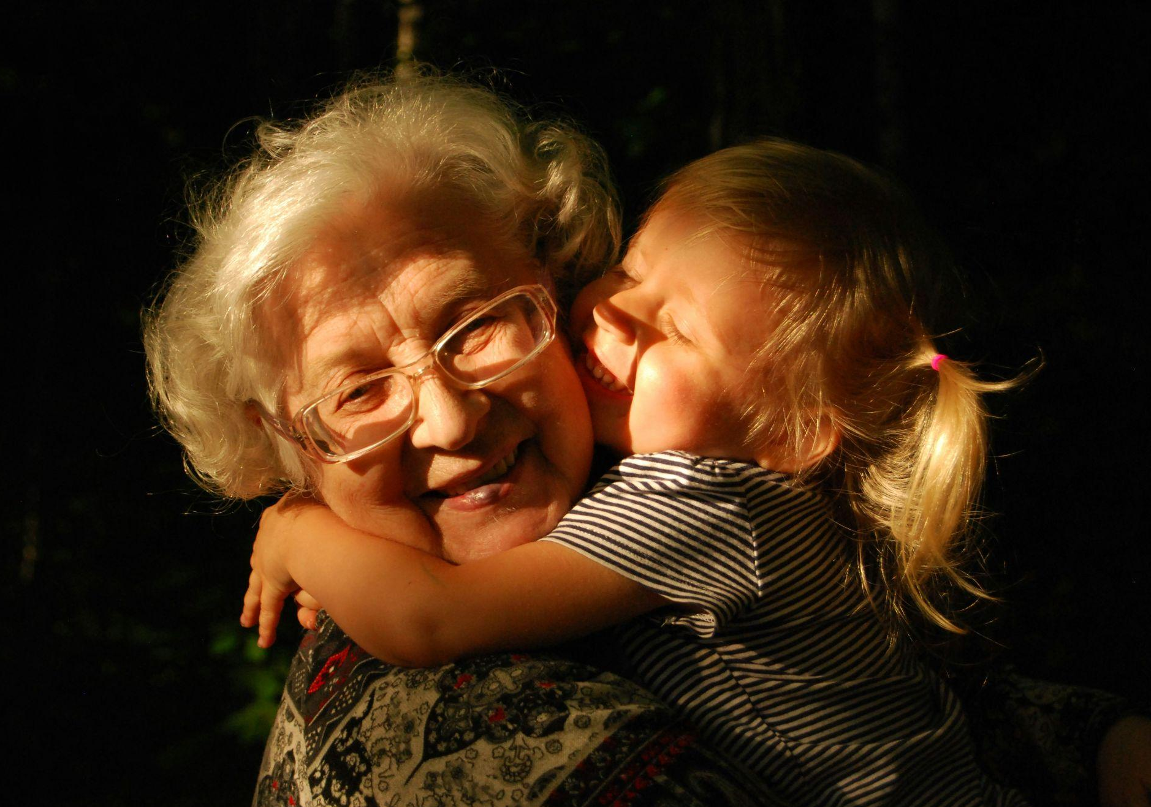


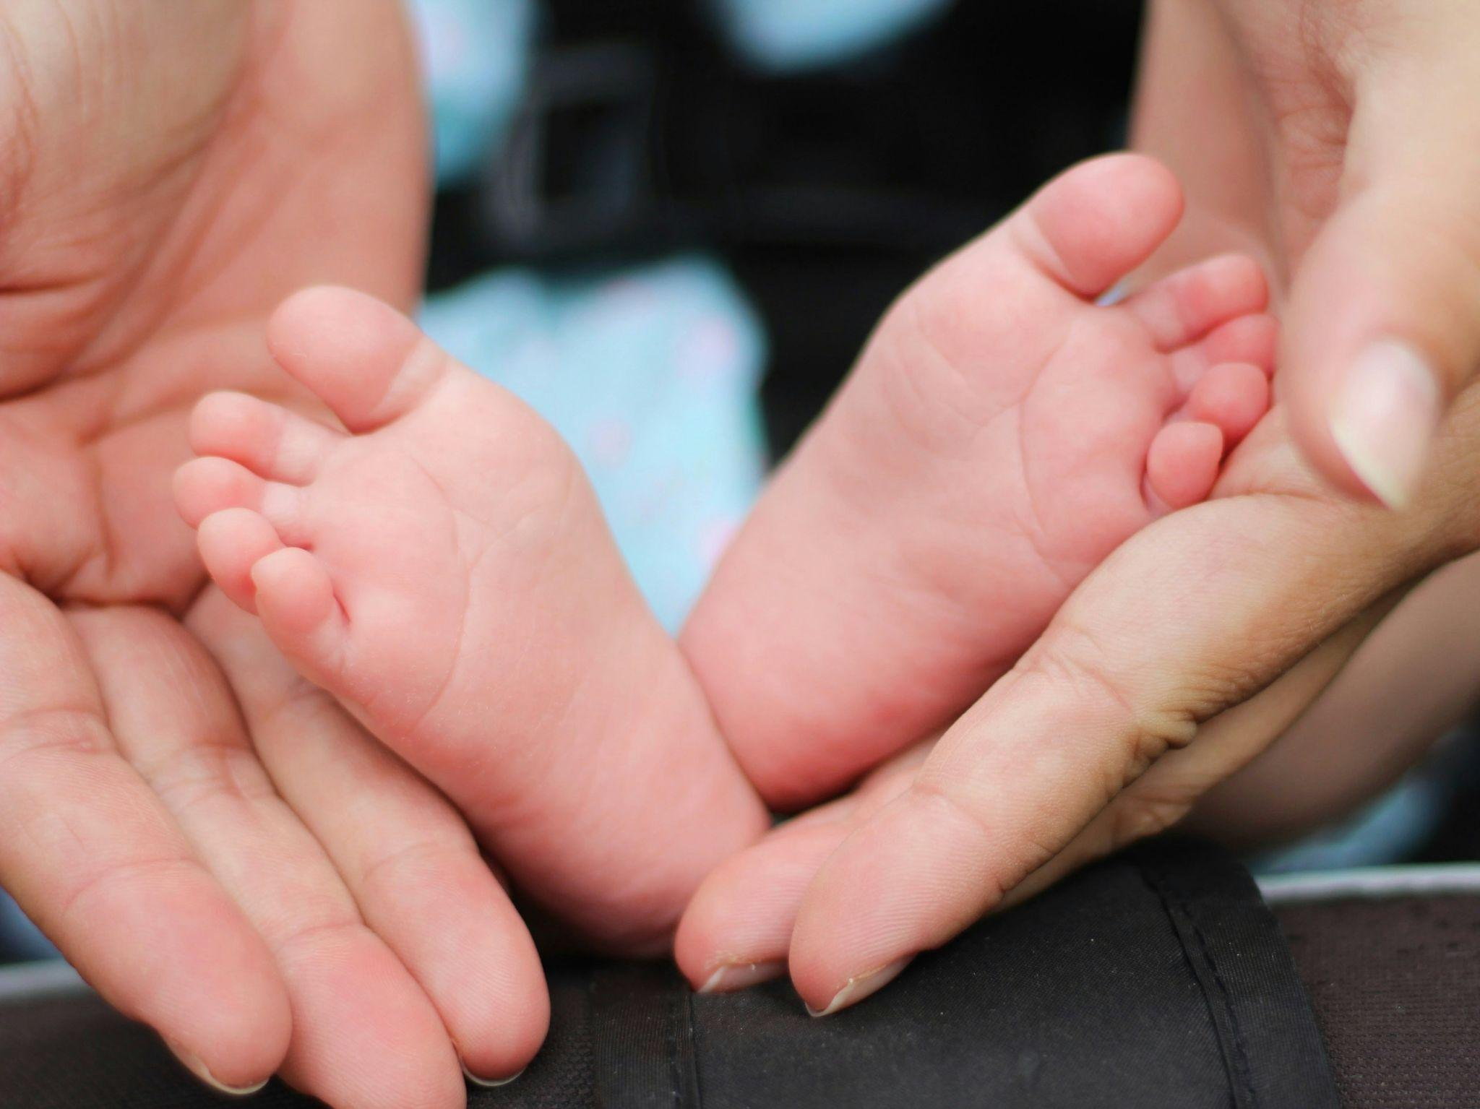


Calvert County Family Network | 2024 Community Assessment
July 2024

Slide 2
About
Since 1999, Calvert County’s Local Management Board (CCFN) has been part of local government, advising the Board of County Commissioners on how to create stable, safe, and healthy environments for children, youth and families. CCFN includes a Board of Directors, a Coordinator under the supervision of the Director of Community Resources, and representatives from various community sectors, including education, health, social services, behavioral health, juvenile services, and youth advocacy.
Ensuring the well-being of our children, youth and families is ongoing, collaborative work, requiring a community-wide effort to create the conditions for equity, belonging and lifelong success. The Calvert County Family Network’s Community Assessment is more than a compilation of data; it reflects our community's commitment to take stock of where we are today as we work together to create a better future for all.
Maryland’s 8 Result Areas
Babies Born Healthy
Healthy Children
Children Enter School Ready to Learn
Children are Successful in School
Youth will Complete School
Youth have Opportunities for Employment or Career Readiness
Communities are Safe for Children, Youth and Families
Families are Economically Stable

Slide 3
Calvert County Family Network Board Members and Staff
Board of Directors
Cindy Scribner, Chair
County Supervisor
Department of Juvenile Services
Deborah Harris, Co-Chair
Citizen Representative
Joseph Cormier
Citizen Member
Jacquelyn Culver
Deputy Director, CCG
Department of Community Resources
Cecelia Lewis
Director of Student Services Calvert County Public Schools
Dr. Kirk Martin
Citizen Representative
Andrea McDonald-Fingland, LCSW-C
Local Behavioral Health Authority
Dr. Laurence Polsky
Medical Director
Calvert County Health Department
Amye Scrivener, LCSW-C
Director
Department of Social Services
Sgt. Joshua Underwood
Calvert County Detention Center
Staff
Julie Mashino
Family Network Coordinator
Ariane Odom
Local Care Team Coordinator
Vision
Calvert County Family Network is committed to achieving a community where all children, youth and families thrive.
Mission
Calvert County Family Network will pursue our vision through interagency collaboration and coordination that provides support for comprehensive services to address the needs of children, youth and families.

Slide 4
Table of Contents
Slide # | Maryland Result Area
26-33 | Babies Born Healthy
34-54 | Healthy Children
55-59 | Children Enter School Ready to Learn
60-72 | Children are Successful in School
73-81 | Youth Will Complete School
82-85 | Youth Have Opportunity for Employment or Career Readiness
86-98 | Communities are Safe for Children, Youth, and Families
99-112 | Families are Economically Stable

Slide 5
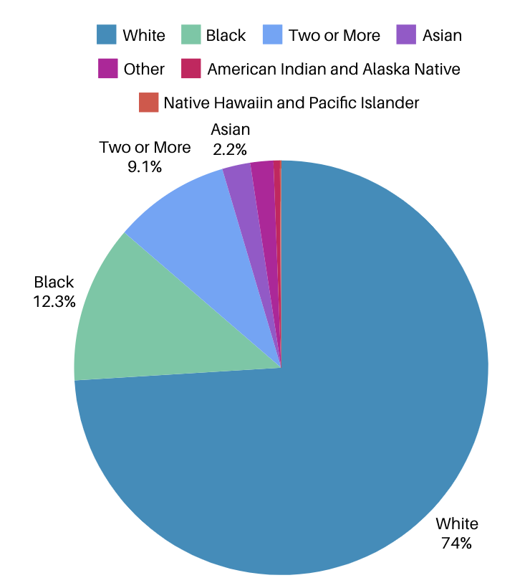
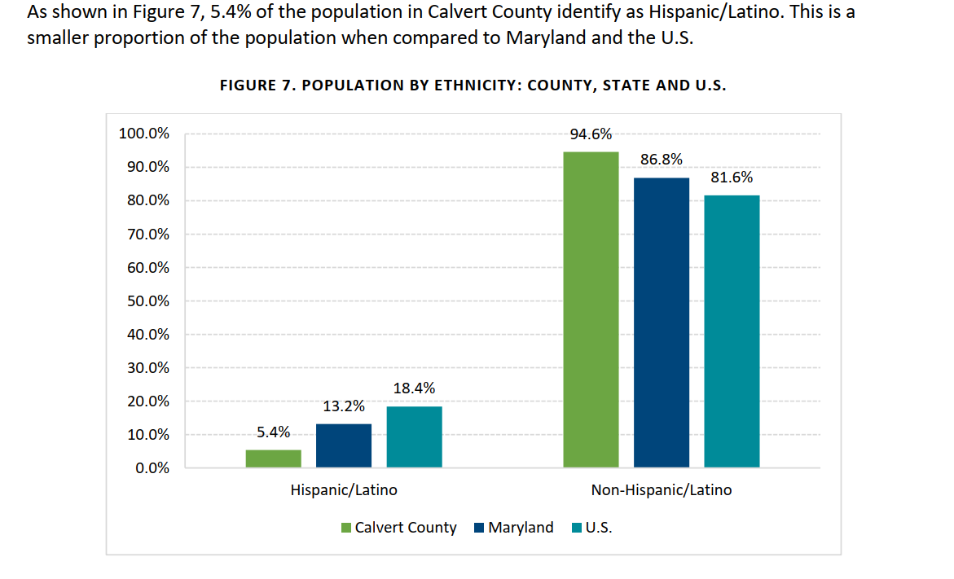
Calvert County Demographics
Population by Race
CHNA Final Report 2023-25

Slide 6
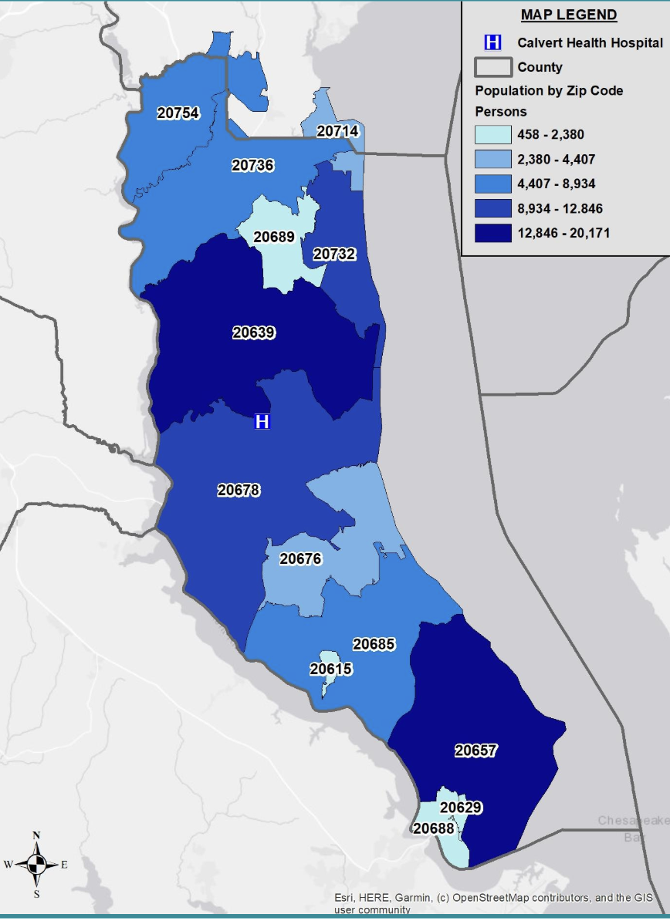
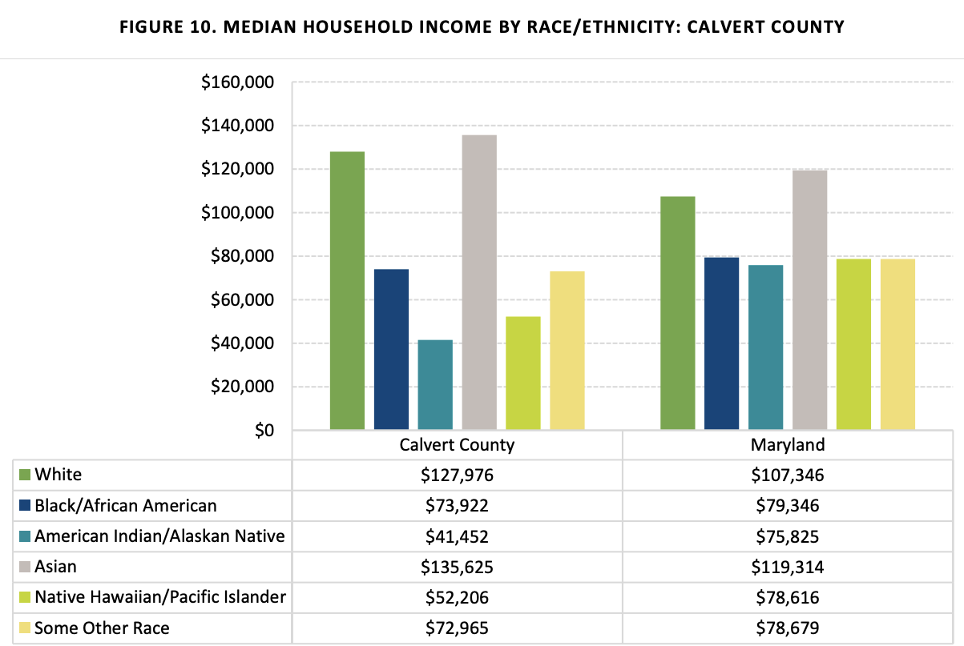
Calvert County Demographics
Population by Zip Code
Median Household Income - 2023
Median household income - $121,051 (Calvert Health)
2.87& of families in Calvert County live below the poverty level (Calvert Health)
Calvert Health Needs Assessment
Calvert Health Needs Assessment

Slide 7
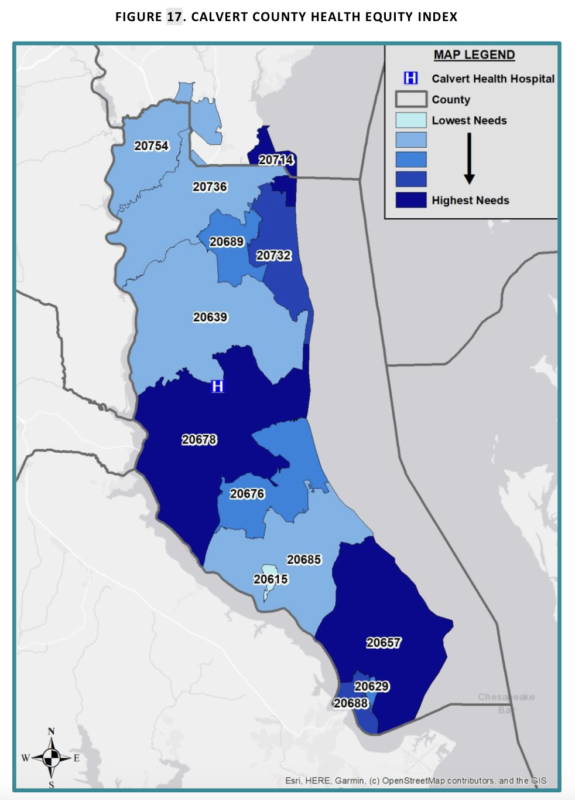
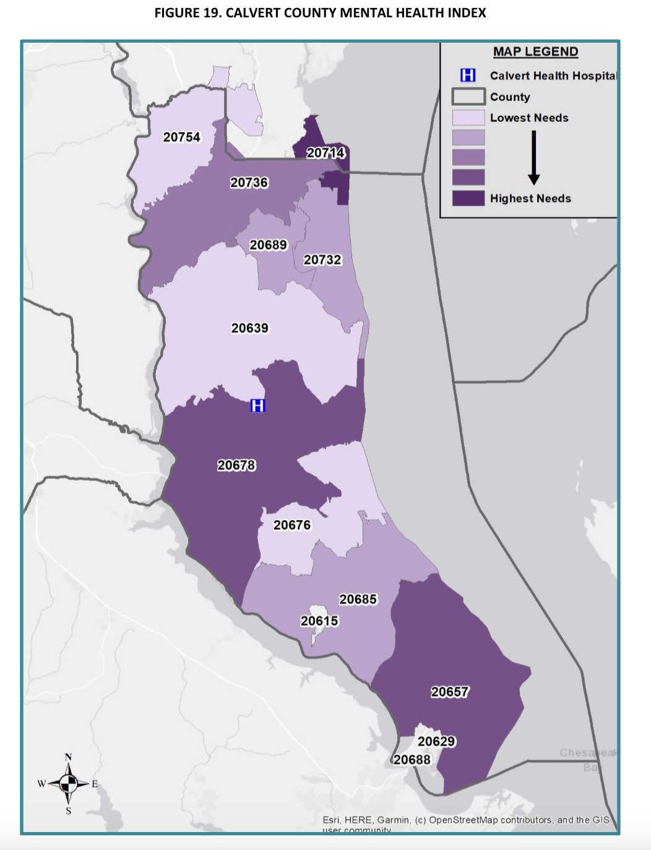
County Health Index Maps
Calvert Health Needs Assessment
Mental Health Index
Health Equity Index

Slide 8

Qualitative
Input Gathering

Slide 9
Who We Heard From - 149 Total
Community Survey (102 Respondents - respondents were able to select all that applied)
Parent or Caregiver (25%) | 40
Community Partner (16%) | 26
Community Member (14%) | 23
Government Agency Partner (11%) | 18
Nonprofit (9%) | 15
Child Care Provider (8%) | 13
Teacher/School Administrator (8%) | 12
Community Advocate (4%) | 6
Other (Library, Board Member, Healthcare Provider/Physician, Social Worker) (4%) | 6
Key Informants (9 Interviewees)
Sheriff’s Office | 2
Youth Centers | 2
Public Schools (DSS) | 1
DJS | 1
LBHA | 1
CCFN - Open Table | 1
Community Activist | 1
Focus Groups (2 Groups - 38 people)
IAC | 26
Youth | 12

Slide 10
Key Takeaways
Mental Health and Substance Use:
Address mental health and substance use disorders:
  Promote services and invest in awareness/education to reduce stigma
  Increase access to services
  Better integration and collaboration with school system
Affordable Housing and Economic Stability
Need for more affordable housing options in the county
  Income needed to afford rent in Calvert County has steadily increased year over year
Transportation:
Limited public transportation options, especially in rural areas, creating challenges for accessing jobs, healthcare, and community resources
Insufficient bike lanes, sidewalks, and safe outdoor play areas for children
Community Safety:
Includes both physical and school safety plus supportive environments
Emphasis on creating safe spaces for children, youth, and families
Early Childhood Support:
Need for quality childcare, early education programs, and ensuring children are ready for kindergarten
Collaboration and Resource Coordination:
Better coordinate services and activities through:
  Enhanced and inclusive communication
  Strengthened partnerships and collaborations
  Increased community engagement
Notes:
Look into mental health

Slide 11

Input Gathering respondents want to live in a community where all children, youth and families are…
Community Survey
Key Informants
Safe, secure and supported
Improved access to resources
Included and educated
Equitable access to opportunities
Parents/Caregivers (additions)
Safe, secure and supported
Valued, included, and empowered
Excellent educational opportunities
Access to resources
Healthy and active
Respected
Equitable access to opportunities
Safe, secure and supported
Access to resources
Community support
Health and happiness
Have a thriving future
Focus Groups
Equitable opportunities and access to resources
Respectful
Drug-free
Basic needs (food, shelter, food, safety)
Engaged and connected
Healthy, supported, and valued
Active
I want to live in a community where all children, youth and families have access to resources regardless of race/ethnicity, socioeconomic status.
Bold = Consensus

Slide 12
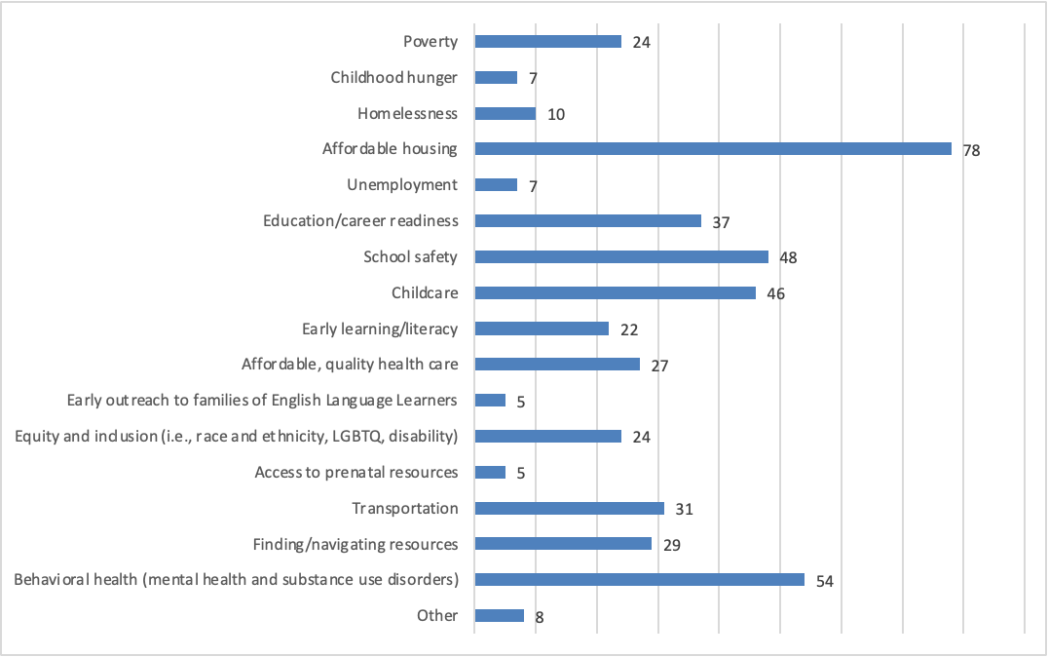
Community Survey
In your opinion, what are the top four challenges children, youth and their families face in Calvert County?
Affordable housing
Behavioral health (mental health and substance use disorders)
School safety
Child care

Slide 13
In your opinion, what are the top four challenges children, youth and their families face in Calvert County?
Key Informants
Focus Group - IAC
Affordable Housing:
Lack of affordable housing leading to long waitlists for housing and limited vouchers
Access to Healthcare and Behavioral Health Services:
Equity issues, including the impact of systemic racism and rising costs of housing, further complicate healthcare access
Childcare and Early Education:
Lack of awareness around childcare services/resources
Transportation:
To daily and extracurricular activities
Affordable Housing and Lack of Transportation
Lack of transportation to mental health services
Limited bus schedule and inconvenient frequency, with a shortage of accessible or well-located stops
Childhood Hunger and Food Insecurity + Economic Challenges (unemployed parents or single parent/income households)
Shortage of Mental Health Services and providers
Lack of knowledge in mental health services
Waitlists for mental health services
School Safety

Slide 14
What’s working locally that addresses these issues that we can build upon?
Bold = Consensus
Key Informants
Community Survey
Focus Group - IAC
Agency Collaboration/Partnership and Community Events and Activities (North Beach First Fridays, Annmarie Gardens events, and the county fair)
Educational and Early Learning Programs (Judy Centers, Head Start, HIPPY, Healthy Families, and Library Programs)
Parent Education/Classes and Support
Health and Behavioral Health Services (intervention programs, initiatives to improve access to services)
Support for Low-Income and Vulnerable Families (food, housing and transportation assistance)
Supportive Housing and Childcare (Yardley Hills, Prime Time Children’s, Youth Centers)
Community and Recreational Programs (Parks and Recreation Department, Library and school systems, Free Public Transportation)
Food Security and Support Services (churches and community organizations, Closing the Gap Coalition, Food Backpack program, summer meal programs for kids)
Health and Behavioral Health Services (Benefits.gov, Mobile Crisis Unit, Youth Centers, Mental Health Expo)
Child and Youth Programs (Judy Centers diaper bank, Big Brothers Big Sisters, Celebrate 8)
Digital Access and Literacy Programs (Chromebook giveaways)

Slide 15
Critical Gaps, Unmet Needs, and Local Resources
Bold = Consensus
Community Survey
Key Informants
Focus Group - IAC
Childcare and Early Education (especially for infants and children with disabilities)
Public Transportation and Youth Activities (insufficient bike lanes, sidewalks, and safe outdoor play areas and youth centers)
Healthcare and Mental/Behavioral Health Access (high costs, lack of insurance acceptance)
Community Awareness and Involvement
Affordable Housing and Homeless (insufficient resources)
School and Community Safety (bullying)
Parental Support and Education
Mental Health and Healthcare Access (unequal distribution of providers)
Affordable Housing and Transportation Services (long waitlists, ineffective vouchers, stigma, lack of transportation)
Childcare Services (regional disparities and differing needs across the tri-county area)
Food Security (pockets of poverty and food deserts especially in southern parts of the county)
Community and Youth Services (youth centers and programs)

Slide 16
Closing the Gap: Mental Health and Substance Use
Community Survey
Bold = Consensus
Key Informants
Focus Group - IAC
Increase Outreach and Awareness (easier resource navigation, partner with schools, community events and activities)
Prevention Approaches (promote resilience, coping skills, and healthy lifestyles)
Regular Follow-Up and Evaluation of Programs
Reduce Stigma (education)
Integrate Services in Schools (separate from guidance counselors)
Expand Provider Network (incentivize providers)
Enhance Access to Services (mobile clinics)
Collaborate with Local Organizations (comprehensive network of care)
Improve Transportation
Enhance Communication and Awareness (social media, local media, schools, and community centers)
Follow-Up and Continuity of Care
Educational and Community Programs (information about the impact of legal and illegal substances on children)
Recruit and Increase Service Availability (specialized services such as speech, orthopedic, and autism therapy)
Youth Involvement and Leadership (peer mentorship)
Reducing Stigma (educate guardians on recognizing substance use in youths)
Improving Accessibility (homeless populations accessing telehealth services)

Slide 17
How can the Family Network better coordinate services and activities?
Community Survey
Parent or Caregiver
Enhanced Communication and Outreach:
Social media and community events
Conduct outreach in lower socioeconomic neighborhoods
Strengthen Partnerships and Collaborations (comprehensive support network)
Parent and Family Engagement (e.g. parenting classes, events, and support groups)
Increase Community Activities and Programs:
More recreational and social activities
Support local parks and recreation programming
Address Stigma and Promote Mental Health:
Combat stigma associated with accessing behavioral health services
Increase Awareness and Outreach:
Through daycares, schools, and social media
Engage with the Community:
Host community forums and focus groups to understand the needs of families
Partner with local schools, churches, and youth organizations for joint events
Expand and Diversify Offerings:
Provide more activities across the county
Develop a youth center specifically for children aged 5-18
Collaborate with Local Partners:
Ensure all collaborative partners share information about client needs and successful strategies
Address Barriers and Gaps:
Engage with local government and school systems for financial and supportive involvement
Streamline grant processes and provide education on available programs and services

Slide 18
How can the Family Network better coordinate services and activities?
Key Informants
Focus Group - IAC
Expand and Strengthen the Network:
Orientation program for new stakeholders
Enhanced School System Collaboration:
Leverage the school system's reach (email, flyers, and social media)
Require sign-off in Code of Conduct
Community and Youth Involvement:
Create areas where youth can congregate safely, feel acknowledged, and be heard
Localized and Targeted Assistance:
Expand mobile services
Install telehealth booths at libraries
Create a Health Hub (no expiration date of care)
Advocacy and Public Engagement:
Conduct public awareness campaigns
  Highlight the positive impact of coordinated services and activities
Improved Communication:
Regular updates and reminders to keep the CCFN website (ourcalvert.org) current
Effective Meetings and Collaboration:
Encourage active participation and collaboration among inter-agency partners
Community Engagement:
Organize events similar to ACE Hardware's block party to showcase CCFN's activities and services
Utilization of Local Resources:
Leverage community assets like the local library for outreach and communication
Cutting Through Bureaucracy:
Assist in reducing bureaucratic “red tape” and other barriers to improve access to services

Slide 19
Which areas should the Family Network prioritize funding over the next 2-3 years?
Community Survey
Key Informants
Focus Group - IAC
Communities are safe for children, youth, and families
Healthy children
Babies born healthy
Families are economically stable
Children enter school ready to learn
Children are successful in school
Youth will complete school
Youth have opportunities for employment and career readiness
* Ranked in order of most to least important
* Parent/caregiver voice included in this ranking
Healthy children
Children enter school ready to learn
Communities are safe for children, youth, and families
Youth have opportunities for employment and career readiness
Families are economically stable

Slide 20
Family Network’s Best Opportunities for Expanded Reach and Impact?
Key Informants
Focus Group - IAC
Collaboration with the School Systems
Targeted support for pre-k and high school
After school activity bus
Improved Communication and Outreach
Share knowledge and inspire action
Help people find alternatives if options unavailable
Expand the board to increase awareness of CCFN and the available community resources
Virtual and in-person outreach
Expand the Board and Partnerships:
Involve more community members and stakeholders on the board to broaden outreach
Coordinating Services and Funding:
Foster collaboration (especially between partners and agencies) to open up more opportunities and streamline services and reduce silos between partners
Address Homelessness and Substance Abuse
Case Management and Navigation Support:
Establish case management services to help families navigate complex systems
Enhanced Communication and Awareness:
Continuously communicate available resources
Engage rental agencies and real estate partners
Inclusive Outreach:
Participate in community events to meet families where they are
Ensure information about services is accessible and relevant to diverse community needs
Community/family network hub
Use QR codes to broaden access
Collaborative Partnerships:
Co-host joint community events and initiatives
Preventive Efforts:
Offer workshops and training sessions on early warning signs and proactive interventions on various issues affecting children, youth and families
Digital Literacy and Social Media:
Offer digital literacy classes to enhance residents' ability to access online resources
Use targeted online campaigns

Slide 21
Key Informants
Considering the work you do and alignment with the Family Network’s mission, are there other ways the Family Network can support your goals and/or deepen its partnership with you?
Collaboration with the Department of Juvenile Services (DJS):
Increase understanding of the evolving role of DJS, emphasizing treatment over punitive actions
Educate families on the new juvenile laws and the supportive role of DJS
Provide more child services that cater to non-delinquent youths in need
Holistic Support Services:
Address the comprehensive needs of children, including social, emotional, and behavioral aspects
Expand parental knowledge on ensuring child safety and health
Connect youths with local college and career opportunities to enhance their future prospects
Enhanced Communication and Resource Awareness:
Continue and expand efforts to create a central resource hub for organizations and families
Ensure the community is aware of available resources, such as childcare and food banks
Strengthen the Family Network’s role as a referral agent for professionals to refer individuals to appropriate services
Training and Funding Utilization:
Increase the usage of existing training and funding by better aligning them with the needs of the community
Offer additional training sessions and funding opportunities to address gaps
Coordinating Youth Services:
Serve as a coordinating force behind county government youth services, ensuring synergy among different services
Facilitate cooperation and communication among various youth service providers
Parent and Caregiver Engagement:
Organize and promote information workshops for parents, especially through Calvert County Public School’s Citizen Advisory Committee
Explore creative ways to engage with parents and caregivers outside of schools to expand awareness of resources
Expanding Knowledge and Access:
Increase knowledge about available resources for youth and their families
Improve access to opportunities that support youth development, including education and career readiness
Supporting Organizational Goals:
Understand the specific goals of partner organizations and align Family Network initiatives to support these goals
Foster deeper partnerships by addressing the unique needs and challenges faced by partner organizations

Slide 22
Focus Group - IAC
Considering the work you do and alignment with the Family Network’s mission, are there other ways the Family Network can support your goals and/or deepen its partnership with you?
Enhanced Communication and Visibility:
Use billboards to display lists of available resources and services
Maintain a comprehensive website where all resources are centralized and easy to access
Post in Facebook groups and other social media platforms to disseminate information
Ensure that the 211 service is widely promoted as a centralized resource hub
Collaboration on Grant Writing and Funding:
Continue collaborating with different providers, especially for grant writing purposes
Work together to identify and apply for new grants that align with shared goals
Dedicate resources to actively seek out and apply for grants that might otherwise be missed
Addressing Digital Barriers:
Collaborate to help community members overcome digital barriers to accessing government portals
Offer support and training to improve digital literacy skills among residents
Promoting Collective Impact:
Emphasize common goals and work towards collective solutions to community challenges
Foster a culture of collaboration where all programs contribute to shared outcomes

Slide 23
Youth Insights - 5th - 9th Grade
Familiarity with Behavioral Health Services for Teens
Feelings of Safety at School
Some feel very safe
Some concerns around physical safety within middle school (e.g. bugs, water damage, and rats in school buildings)
Limited familiarity
Some awareness of therapists and doctors
Views on Mental Health Issues Among Peers and Community
Ineffective Health and Safety Measures in School
Seen as an embarrassment
Need to normalize seeking help to reduce stigma
Belief that if more people used services, it would reduce embarrassment
Education on vaping and drugs perceived as ineffective
Many students disregard anti-drug/vaping messages

Slide 24
Youth Insights - 5th - 9th Grade
Ideal School Climate
Teachers being nicer and more knowledgeable
Fair treatment and consistent rule enforcement
Additional Community Improvements
Addressing racism
Affordable housing
More recreational facilities and activities
Improved infrastructure (sidewalks, bike lanes)
Safe spaces for recreation
Anti-bullying measures
More affordable cost of living
Better recreational opportunities for all ages
Fair Enforcement of Rules
Concerns about inconsistent enforcement (dress code)
Issues with follow-through on support for students with special needs
Desire for equal treatment regardless of mental/behavioral health issues

Slide 25

Quantitative Input Gathering

Slide 26

Babies Born Healthy

Slide 27
Why is this important?
Babies Born Healthy have a better start in life, with reduced risks of immediate and long-term health complications. Healthy births typically result in lower healthcare costs and reduced strain on medical resources. Healthy starts positively impact a child's physical, cognitive, and emotional development, which can affect success in school, social interactions, and overall quality of life. On a broader scale, improving birth outcomes is crucial for reducing infant mortality rates and addressing health disparities in communities.
Looking specifically at babies being born in Calvert County, the data highlighted some concerning disparities and trends in maternal and infant health:
Black mothers experienced over twice the rate of low birth weight babies compared to other groups from 2018-2020
Black/African American and Hispanic mothers were significantly less likely to receive prenatal care compared to White mothers
Infant mortality rates have been increasing since 2017
These statistics reveal persistent racial disparities in maternal and infant health outcomes. Black and Hispanic mothers in Calvert County are less likely to get adequate prenatal care and more likely to have babies with low birth weight, reflecting systemic and other barriers to accessing care.
What's more, since 2017, there has been a troubling increase in infant mortality rates that reverses previous improvement trends, affecting overall population health metrics and suggesting broader issues in maternal and infant healthcare.
Poor outcomes at birth can lead to persistent health issues for both mothers and babies, and often ripple throughout a child's life, from early development through school and life. The data indicates a complex problem involving racial disparities, healthcare access issues, and declining progress in infant health outcomes, underscoring the need for targeted interventions to address these disparities and improve maternal and infant health across all communities.

Slide 28
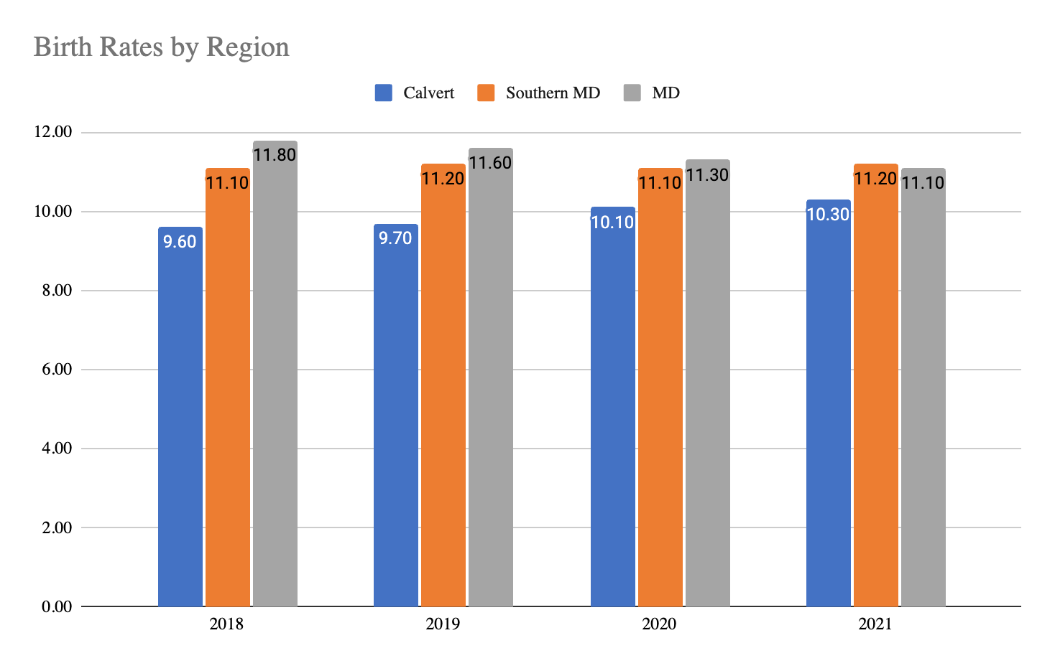
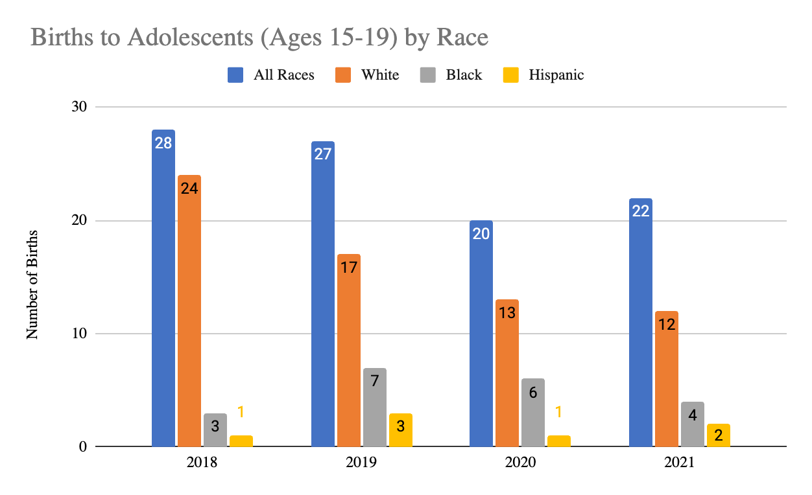
Prenatal and Birth Outcomes
Birth Rates by Region
Birth to Adolescence
Birth to Adolescence: The rate of births to adolescent females ages 15 through 19 years per 1,000 in the age specific population.
Maryland Vital Stats Reports 2018-2021

Slide 29
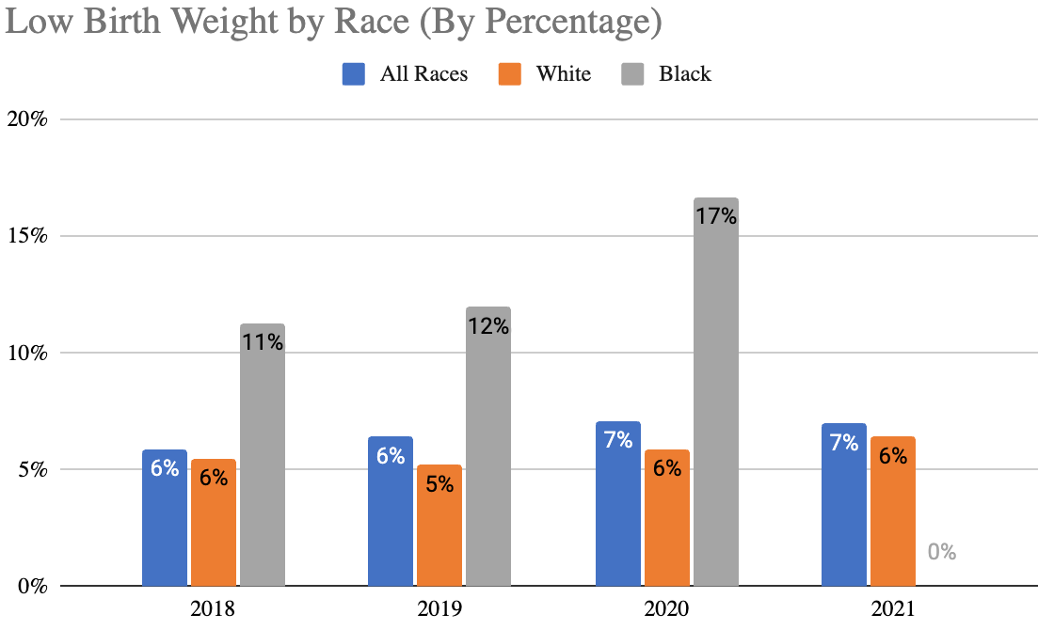
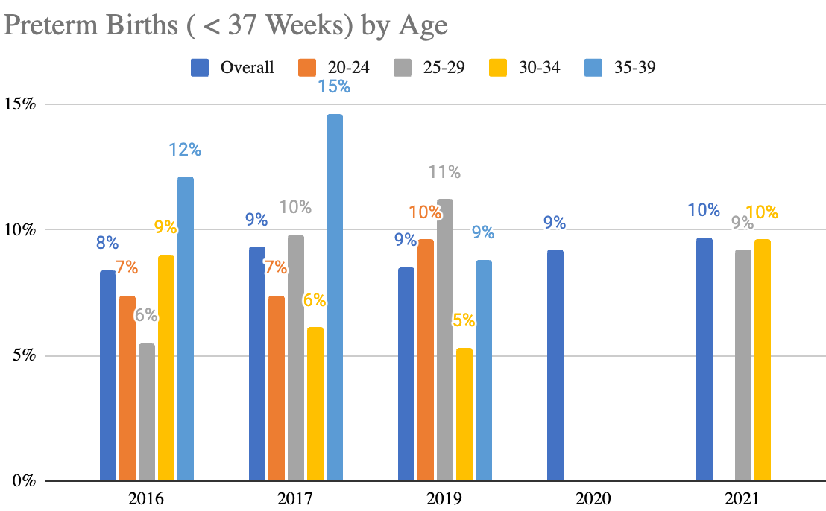
Prenatal and Birth Outcomes
Low Birth Weight by Race
Preterm Births by Age
Low Birth Weight: The percent of all births and births in selected racial groups with birth weight less than 2,500 grams (approximately 5.5 pounds). Very low birth weight (1,499 grams or less) is not included here.
Preterm Births: The percent of all births and births in selected racial groups born prior to 37 weeks gestation.
Maryland Vital Stats Reports 2018-2021
Healthy Calvert
*2021 data not included for Black population due to numbers <20
*Data from 2020 and 2021 was not listed for all ages as previously included

Slide 30
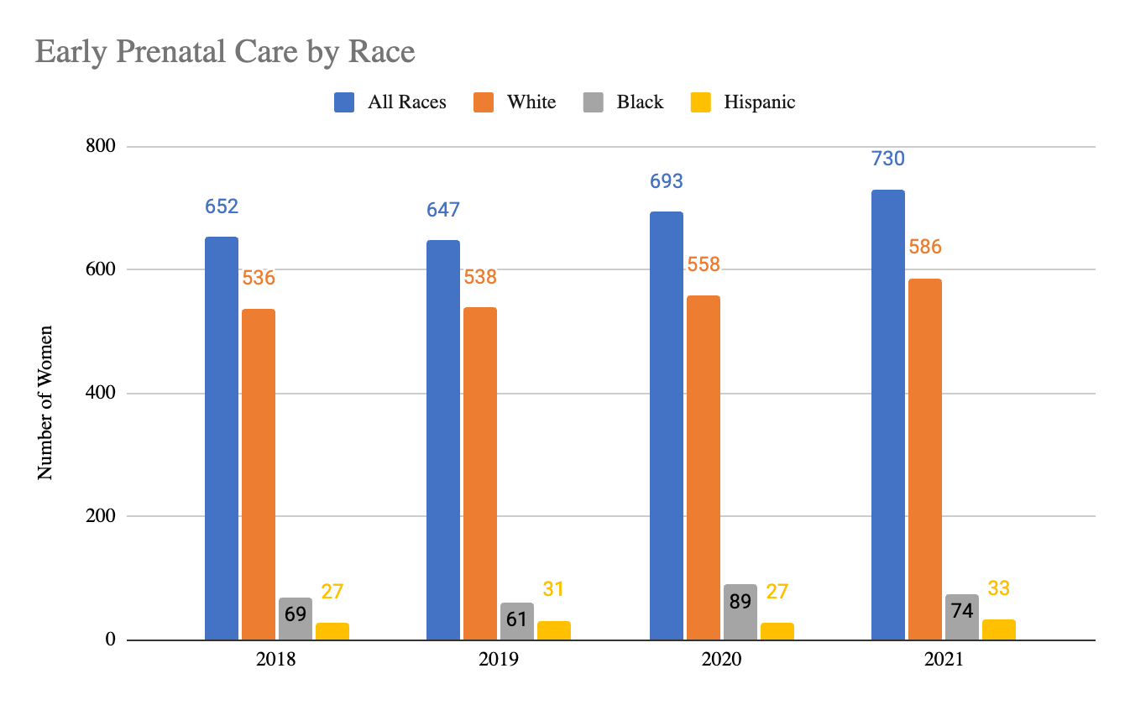
Prenatal and Birth Outcomes:
Early Prenatal Care by Race
Early Prenatal Care: The percent of all births and births in selected racial groups with prenatal care beginning in the first trimester.
Maryland Vital Stats Reports 2018-2021

Slide 31
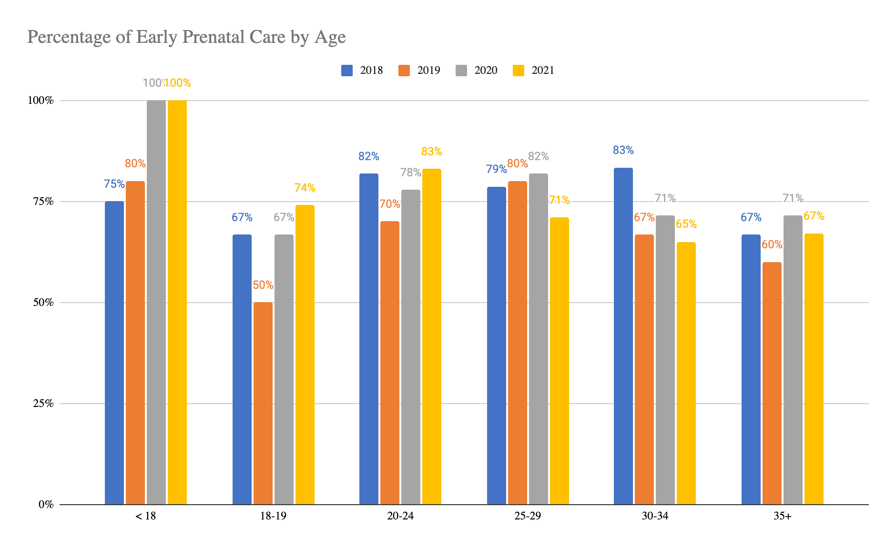
Prenatal and Birth Outcomes:
Early Prenatal Care by Age
Maryland Vital Stats Reports 2018-2021

Slide 32
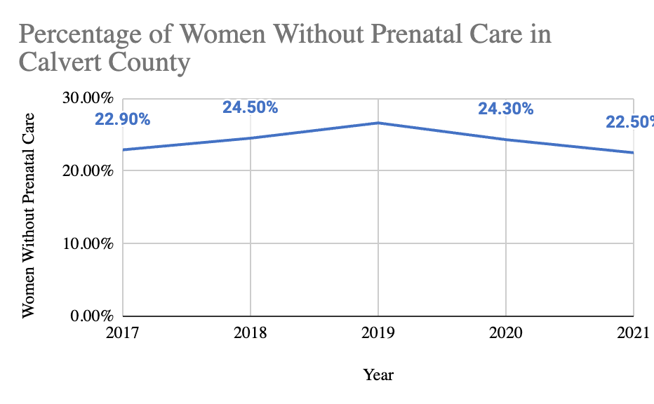
Prenatal and Birth Outcomes: Women Without Prenatal Care
MD Family Network

Slide 33
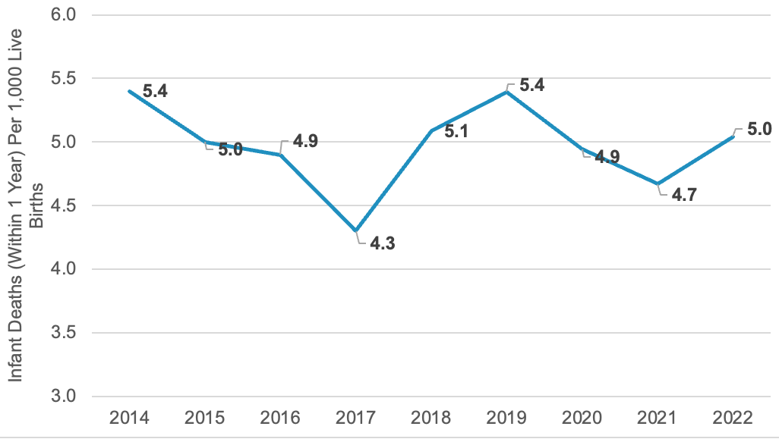
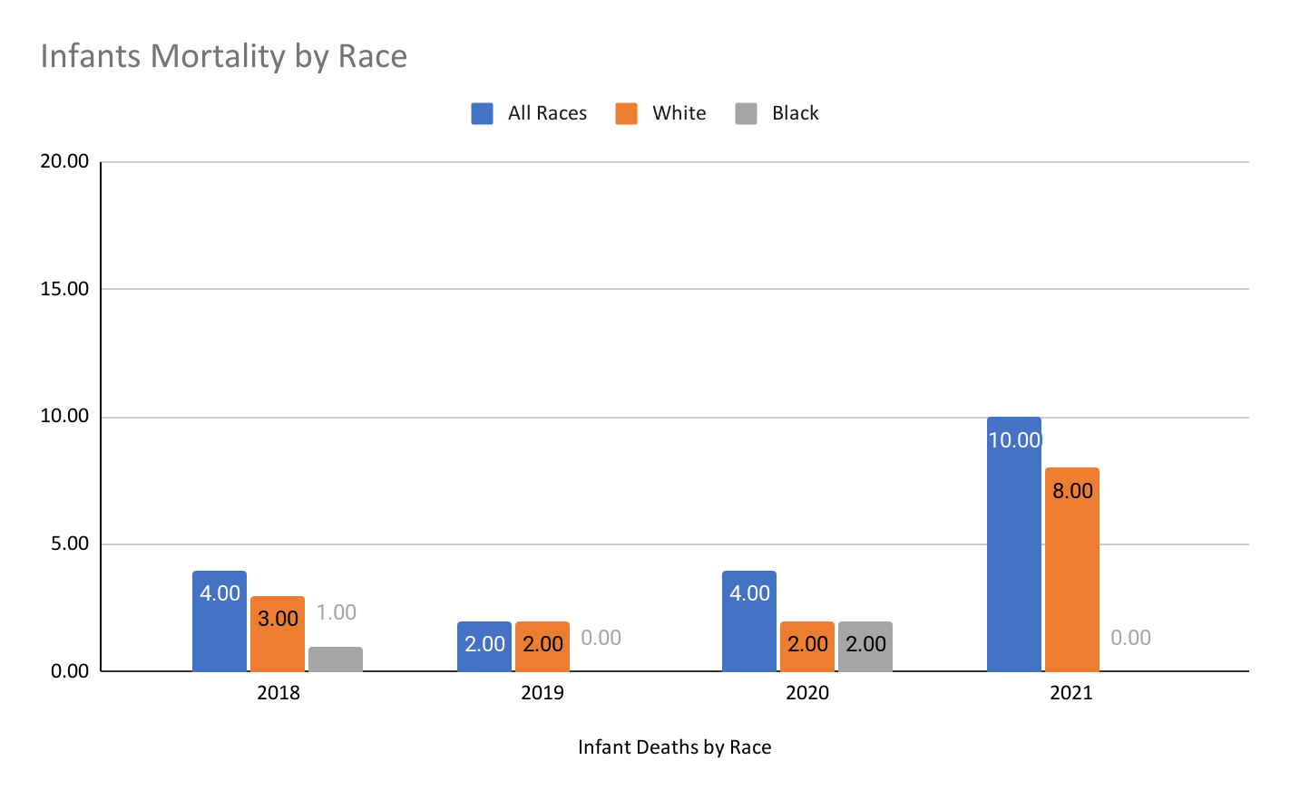
Prenatal and Birth Outcomes
Infant Mortality
Infant Mortality by Race
Infant Mortality: The number of deaths occurring to infants under one year of age per 1,000 live births, for all infants and for infants in selected racial groups.
Maryland Department of Health

Slide 34

Healthy Children

Slide 35
Why is this important?
Ensuring Healthy Children is crucial for overall childhood development and future well-being. A healthy child is better equipped to learn, grow, and reach their full potential physically, mentally, and emotionally. Good health in childhood also sets the foundation for a healthier adulthood, reducing the risk of chronic diseases later in life.
Recent data from Calvert County provides crucial insights into the overall health, mental health and substance use patterns among local children and youth:
Self-harm rates are relatively stable overall but disproportionately affect females
Since 2014, there has been an increase in middle and high school students reporting feeling sad or hopeless each year
High school students have experienced an increase in suicidal thoughts yearly from 2014 to 2022
While youth substance use has generally declined, marijuana remains the most commonly used substance and is most likely to result in juvenile offenses
These trends paint a concerning picture of youth mental health and substance use in Calvert County. While intentional self-harm rates have remained relatively stable overall, they disproportionately affect females, highlighting a gender-specific issue that requires targeted solutions. Compounding this, there has been a consistent year-over-year increase since 2014 in the percentage of middle and high school students reporting feelings of sadness or hopelessness, indicating a broader decline in youth mental health well-being. Even more alarming is the rise in suicidal thoughts among high school students over the same period, suggesting that mental health challenges are becoming more severe for many adolescents. On the plus side, youth substance use has declined across all substances and populations; however, the persistent prevalence of marijuana use remains a concern, as it continues to be the substance most frequently associated with juvenile offenses.
With increased resources and focused interventions, there is tremendous potential to reverse these trends, supporting our youth in building resilience, improving mental health, and paving the way for a brighter, healthier future.

Slide 36
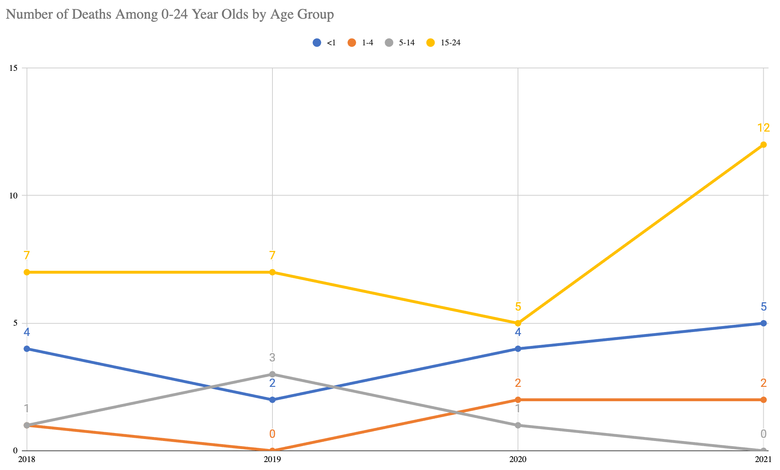
Child Health:
Child Deaths
Child Deaths: The rate of deaths to children ages 0-21 per 100,000 in the age-specific population.
Maryland Vital Stats Reports 2018-2021

Slide 37
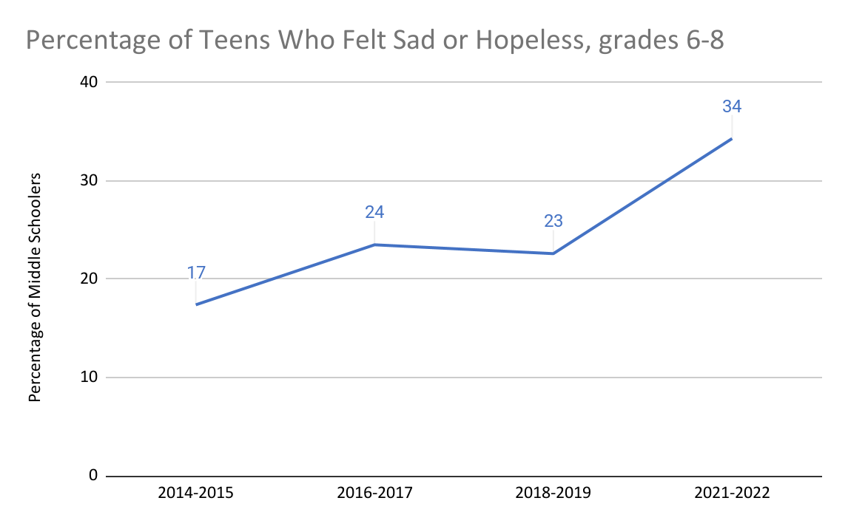
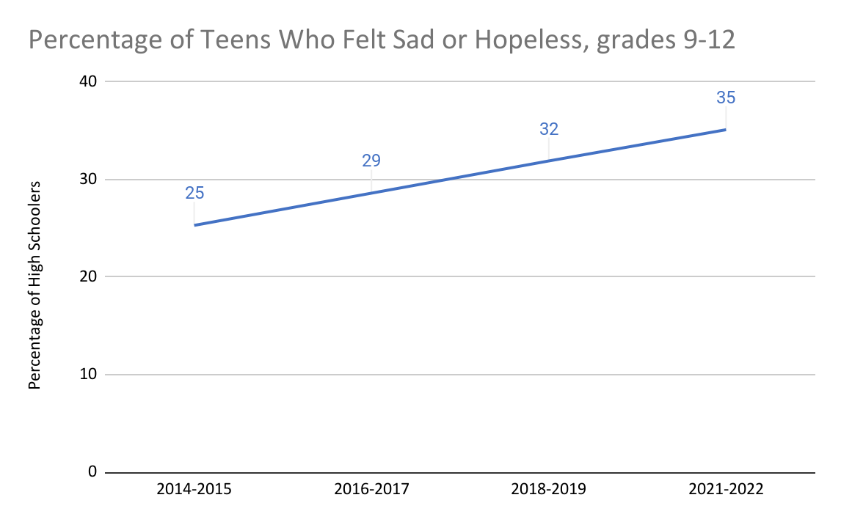
Healthy Calvert
Child Health:
Depressive Episode
Depressive Episode: The percent of public school students in grades 9-12 reporting a depressive episode.

Slide 38
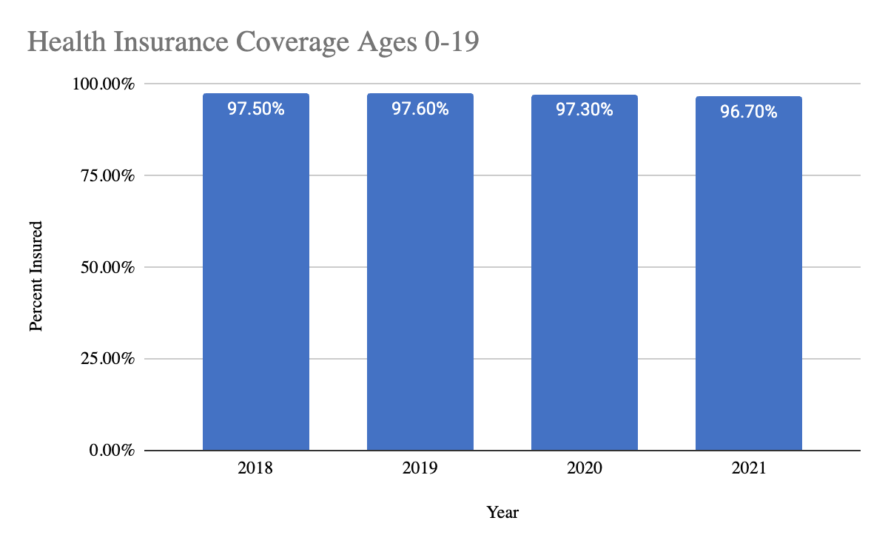
Child Health:
Health Insurance Coverage
Health Insurance Coverage: The percent of children who have health insurance coverage.
United States Census Bureau, Small Area Health Insurance Estimates

Slide 39
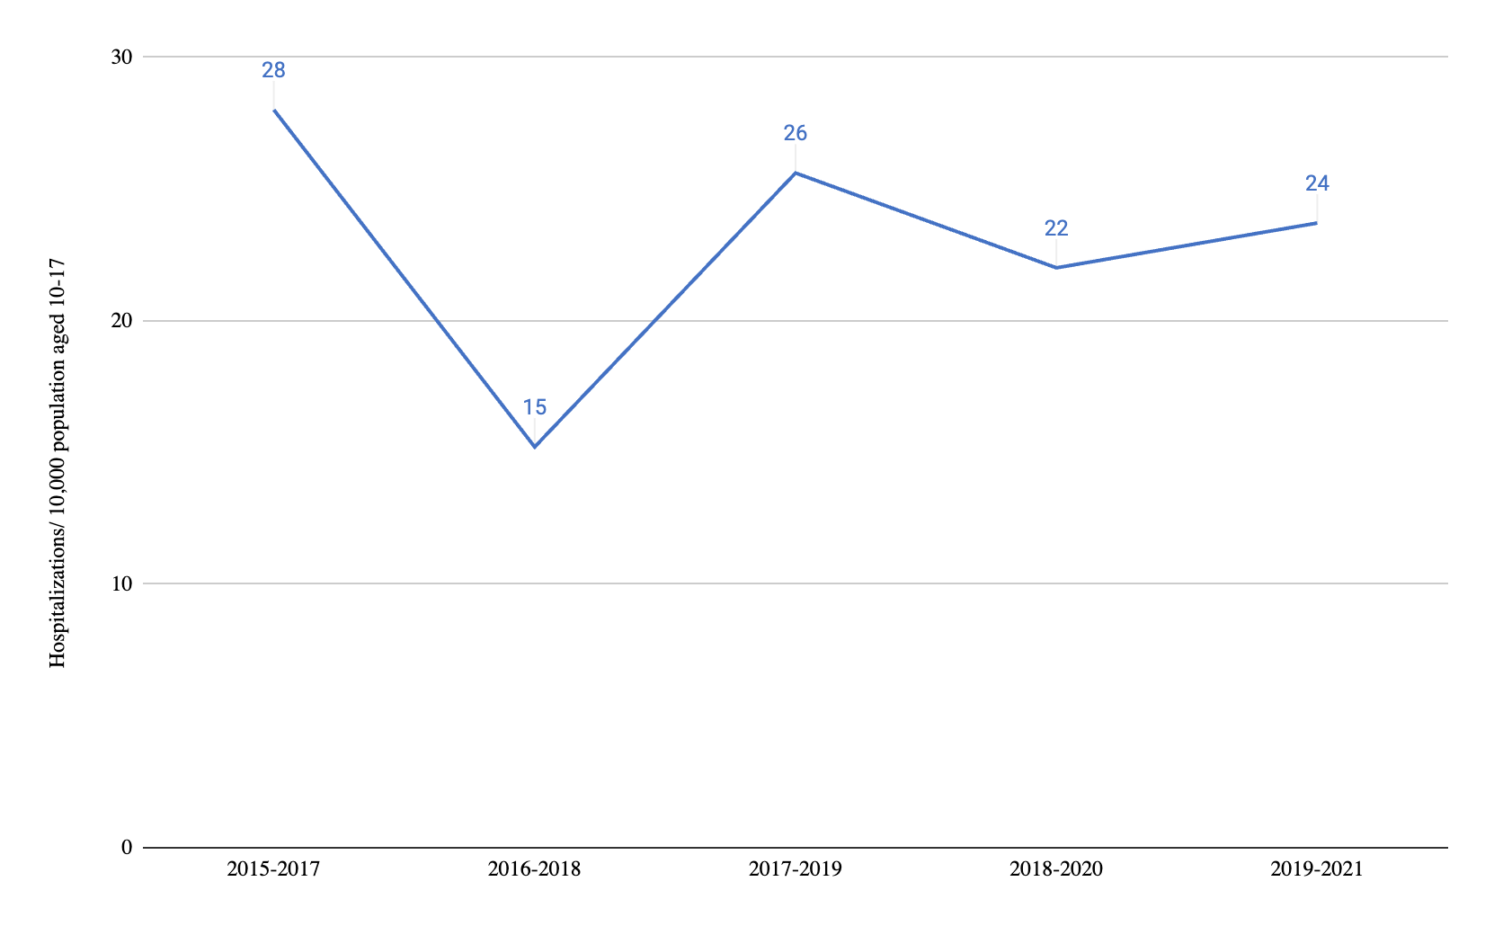
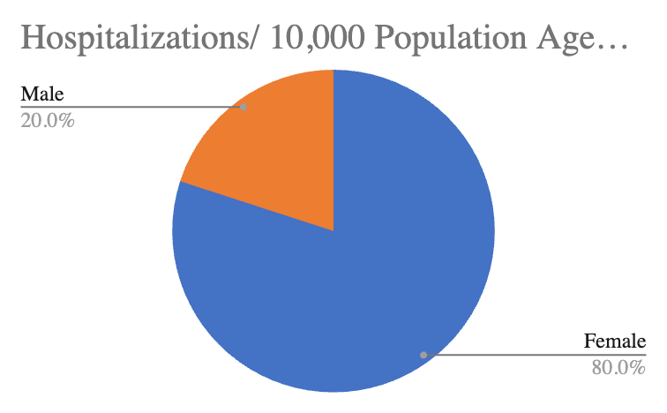
Child Health
Hospitalizations: Intentional Self-Inflicted Injuries
Hospitalizations: Intentional Self-Inflicted Injuries, by Gender, 2019 - 2021
Hospitalizations (Self-Inflicted Injury): Age-adjusted hospitalization rate due to adolescent suicide and intentional self-inflicted injury per 10,000 population aged 10-17.
Healthy Calvert

Slide 40
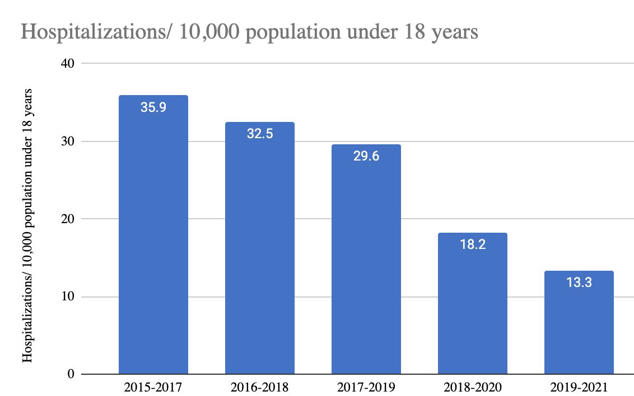
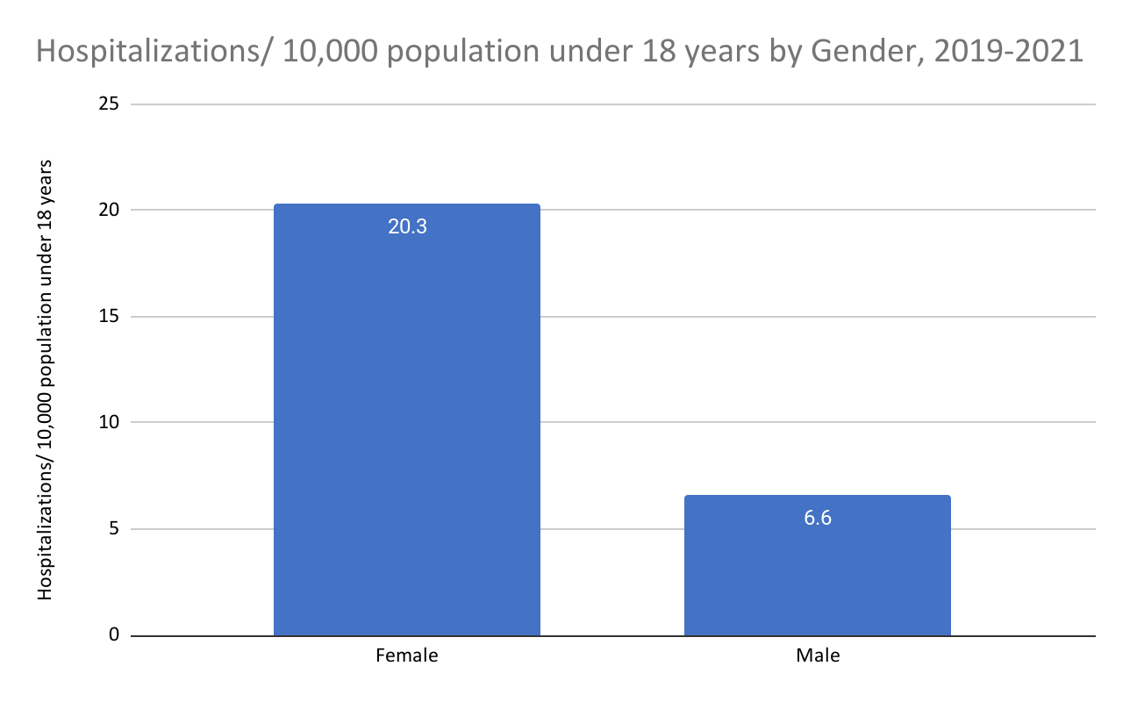
Child Health
Pediatric Mental Health Hospitalizations
Pediatric Mental Health Hospitalizations, by Gender
2019 - 2021
Hospitalizations (Pediatric Mental Health):Age-adjusted hospitalization rate due to mental health per 10,000 population under 18 years
Healthy Calvert

Slide 41
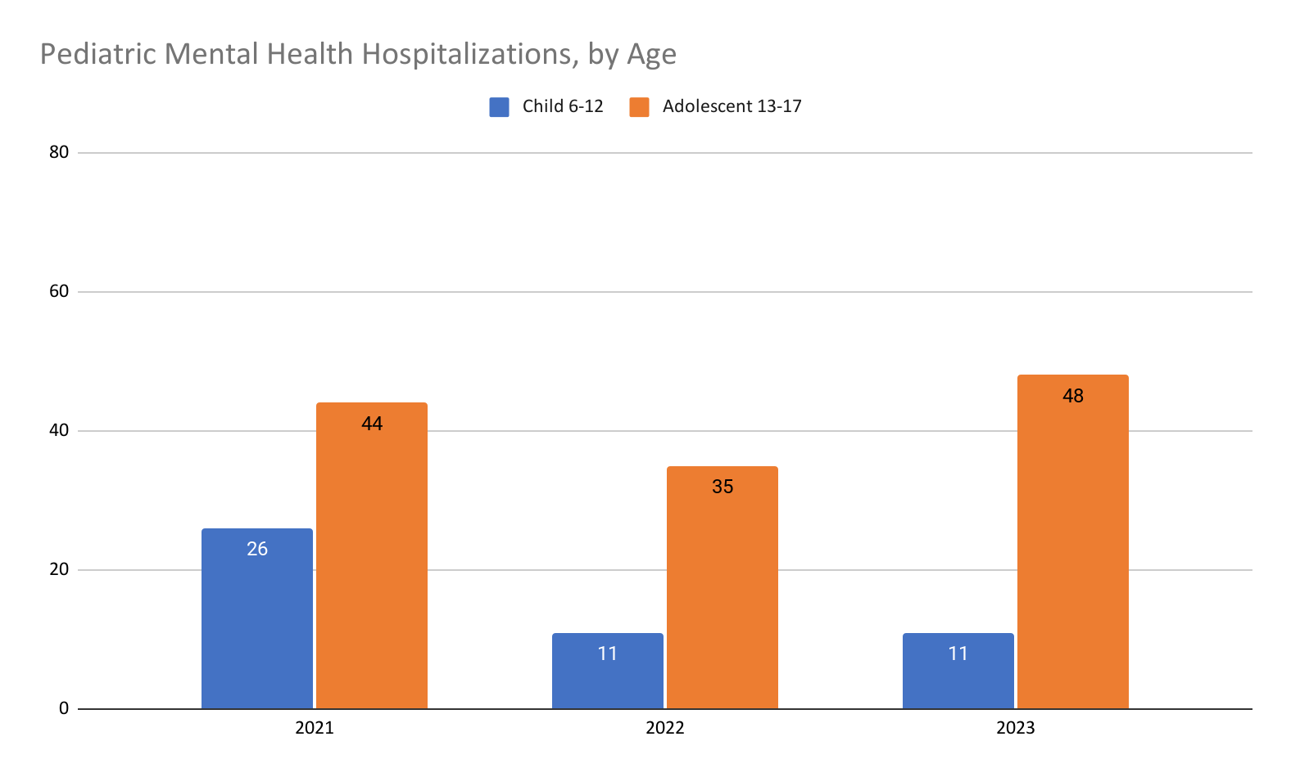
Child Health
Pediatric Mental Health Hospitalizations, by Race
2021:
Emergency room recipients were more likely to be female (57.4%) and Non-Hispanic Black (37.8%)
Non-Hispanic Whites accounting for (28.7%)
Female children and young adults used emergency room services at a rate of 13 per 1,000 eligible
Male children at a rate of (12 per 1,000 eligible)
Non-Hispanic White children and young adults used emergency room services at a substantially higher rate than Non-Hispanic Black children and young adults (22 per 1,000 eligible versus 15 per 1,000 eligible)
Annual Report on Behavioral Health Services for Children
MARF Data Report
*Hospitalizations are categorized as “Inpatient” meaning - 24 hour inpatient level of care that provides highly skilled psychiatric services to youth with severe mental disorders.
**Early Child 0-5 data was suppressed. Data not shown was also suppressed.

Slide 42
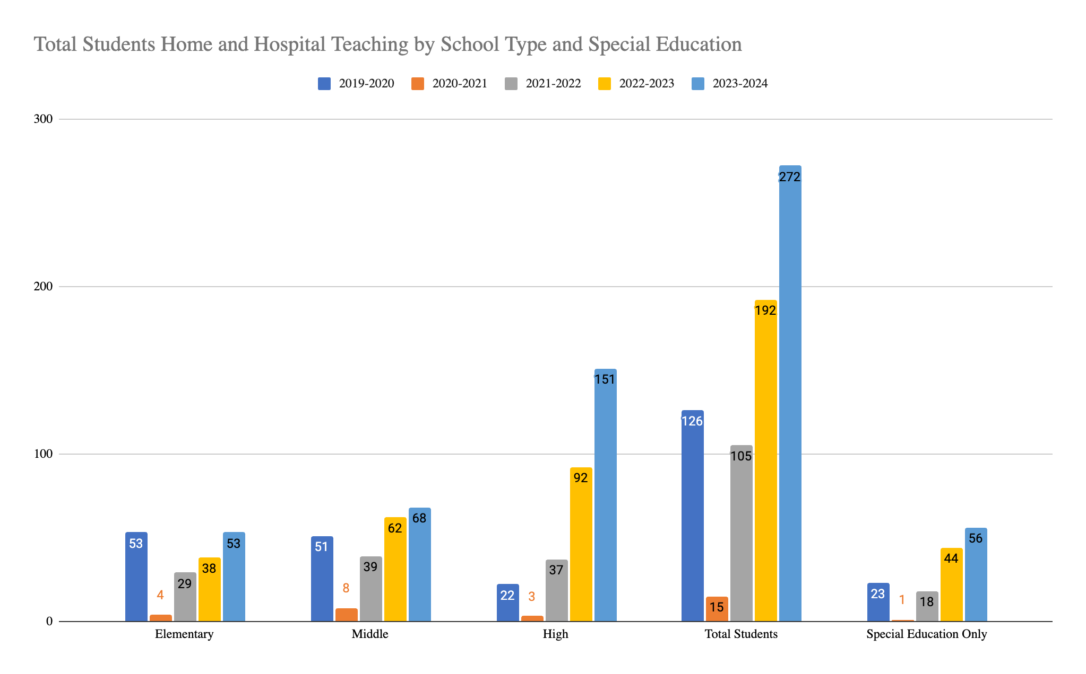
Child Health:
Home and Hospital Teaching
Hospitalizations (Home and Hospital Teaching, CCPS): The number of occurrences for home and hospital teaching per school year
*Number of total students in 2020-2021 is lower than other years due to all students attending school at home across school types
Calvert County Public School District
Notes:
Look into mental health

Slide 43
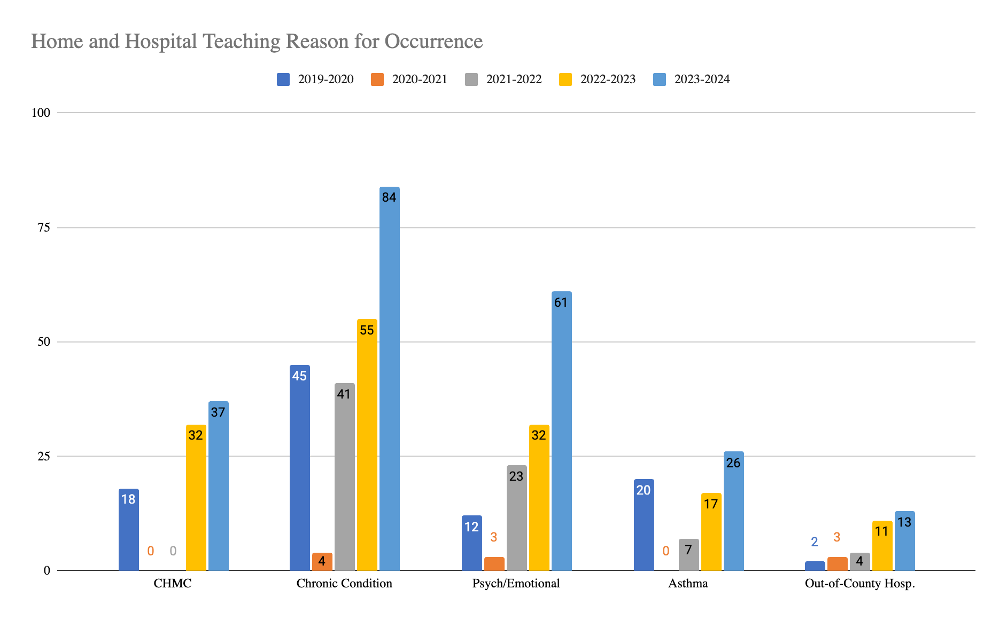
Child Health:
Home and Hospital Teaching Reason for Occurance
*Number of occurrences in 2020-2021 is lower than other years due to all students attending school at home across school types
Calvert County Public School District
Notes:
Look into mental health

Slide 44
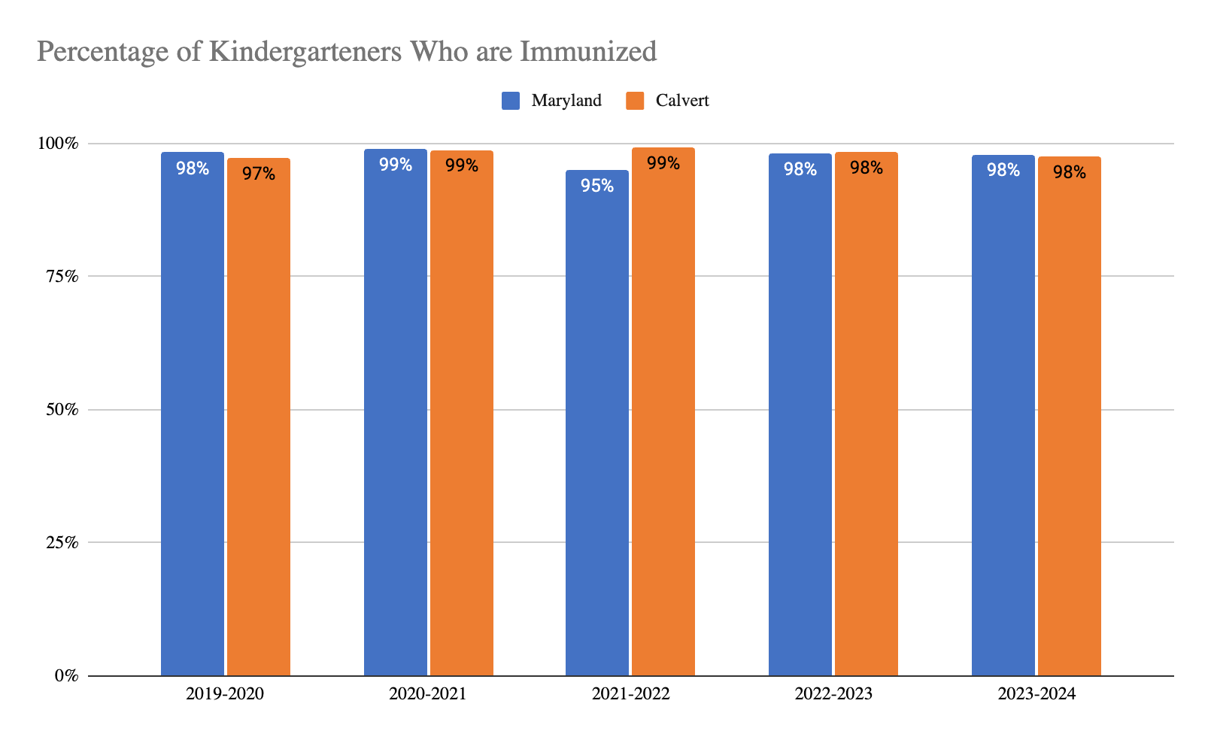
Child Health:
Immunizations - Kindergarteners
Immunizations: The percent of children ages 35 months through 19 years who have received the full schedule of recommended immunizations. The recommended full schedule is four doses of Diphtheria-Tetanus-Pertussis, three doses of Polio, two doses of Measles, Mumps, Rubella, three doses of Hepatitis B and two doses of Varicella.
Maryland Department of Health, Annual Report of Immunization Status: Kindergarten Students

Slide 45
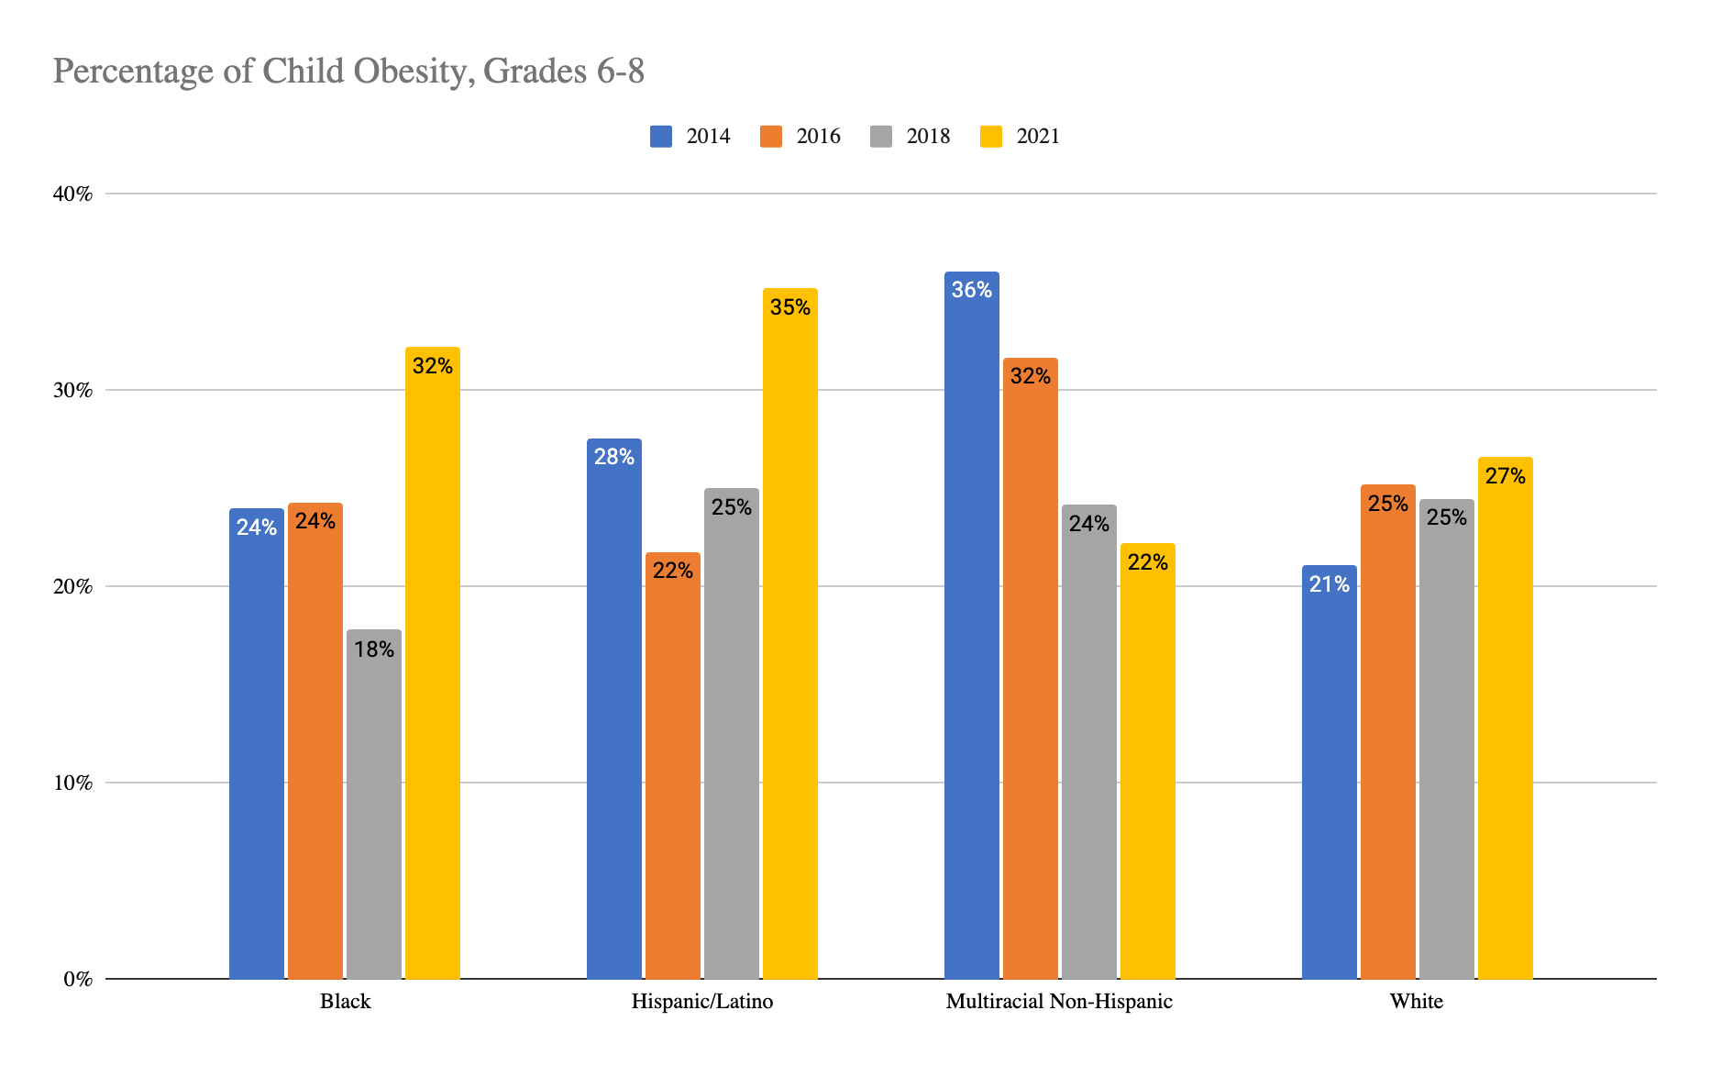
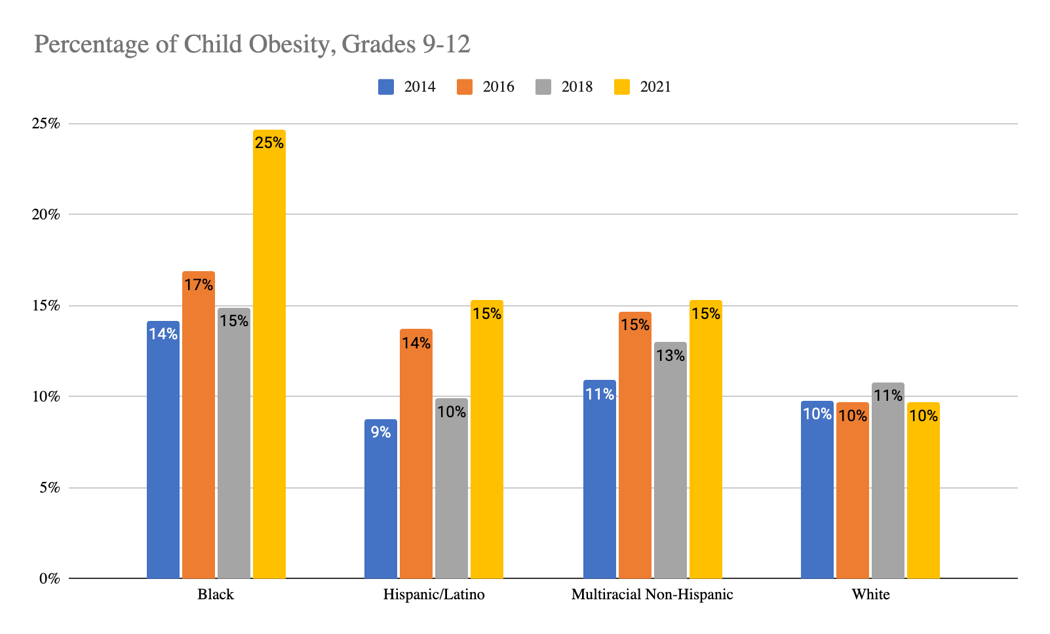
Child Health:
Obesity
Obesity: The percent of Maryland public school students in grades 9-12 who are overweight or obese.
Youth Risk Behavior Survey

Slide 46
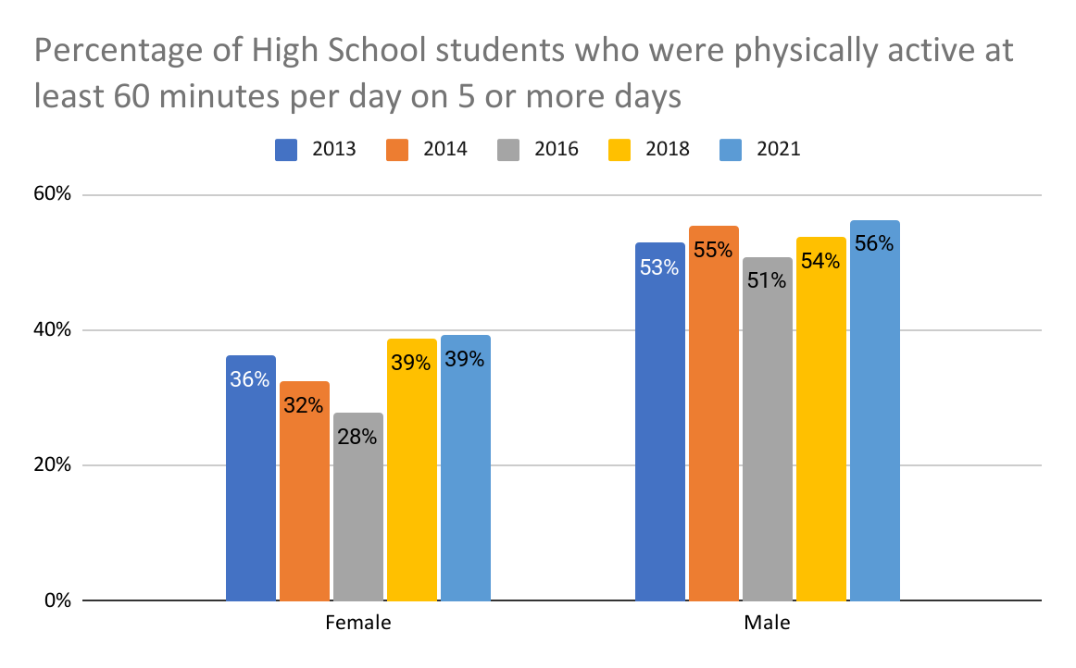
Child Health:
Physical Activity
Physical Activity: Percentage of students who were physically active at least 60 minutes per day on all seven days.
Youth Risk Behavior Survey

Slide 47
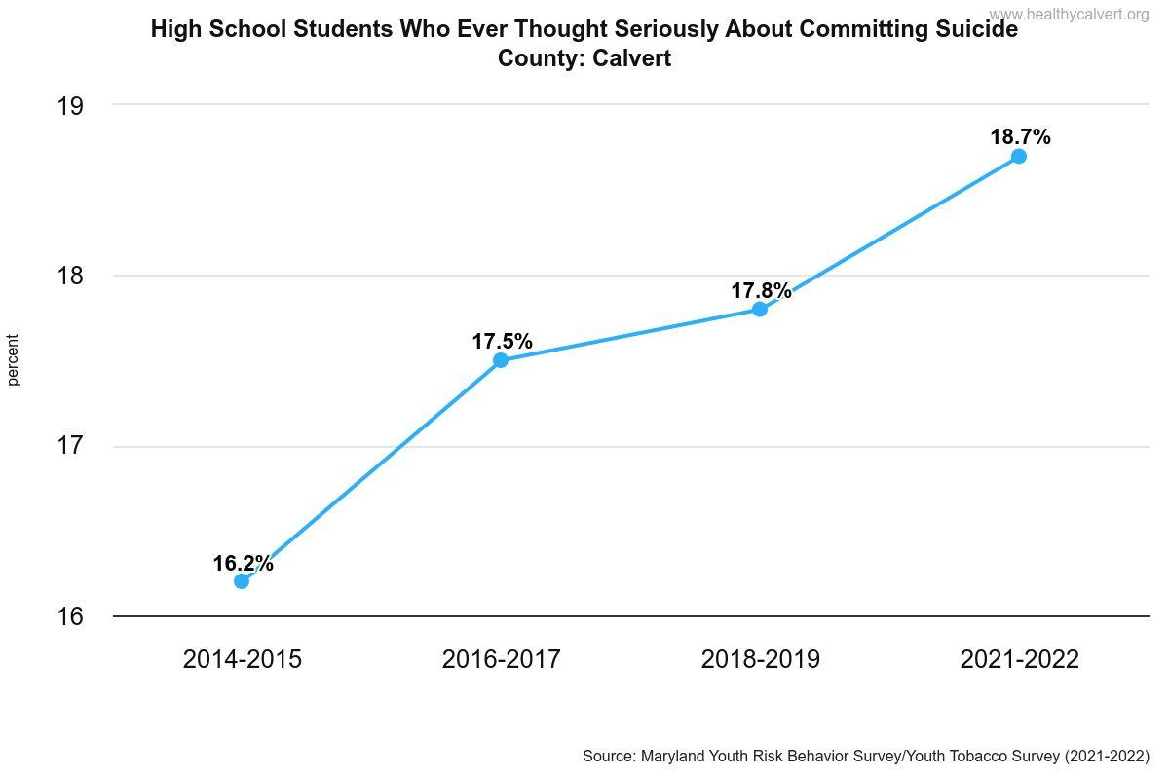
Child Health:
Suicidal Thoughts
Healthy Calvert
Notes:
Look into mental health

Slide 48
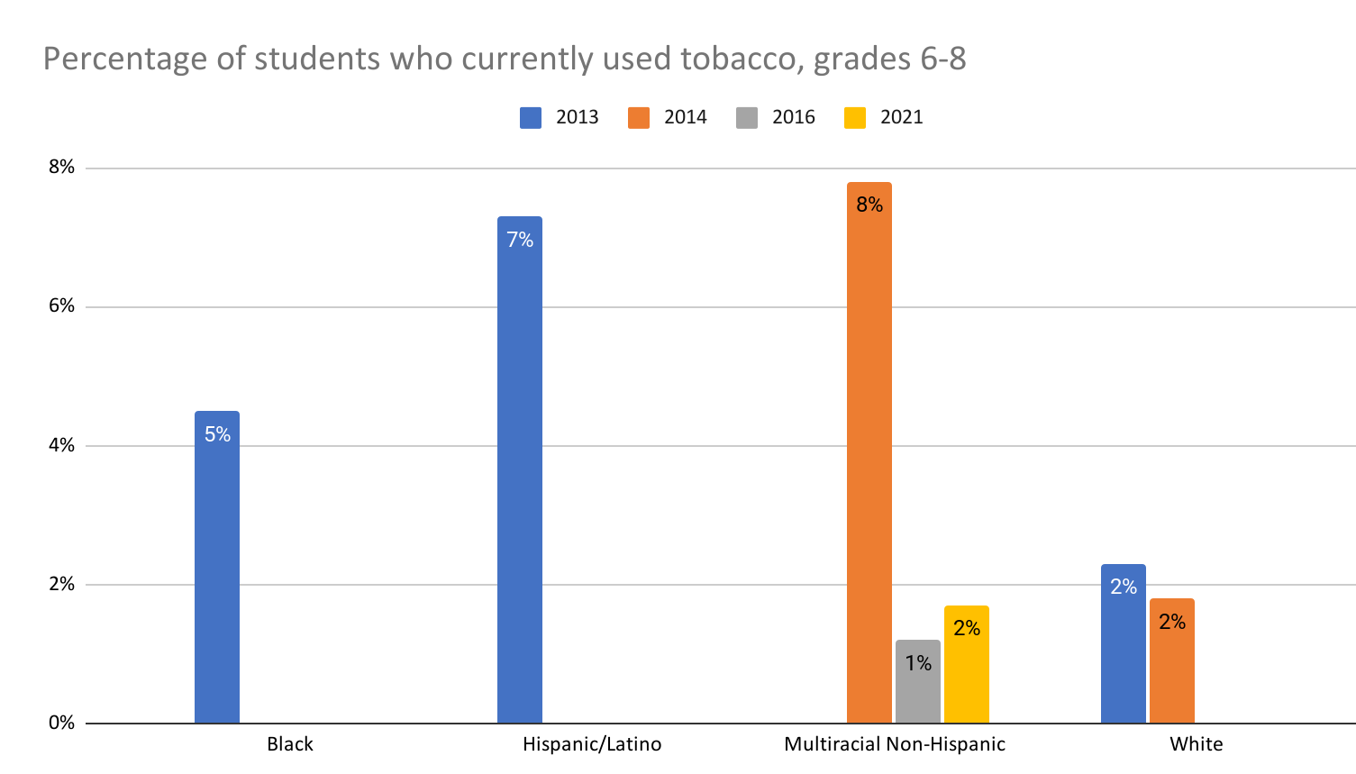
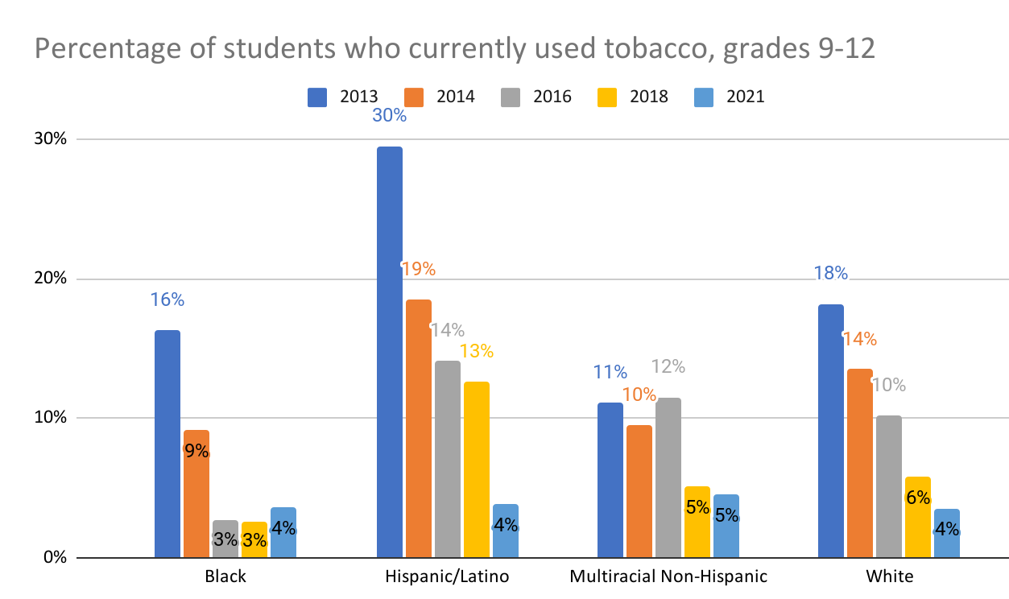
Child Health:
Tobacco Usage
*Data missing was not provided/suppressed in YRBS
Substance Use: The illegal use of alcohol, tobacco, and other drugs (ATOD) by Maryland youth.
Youth Risk Behavior Survey

Slide 49
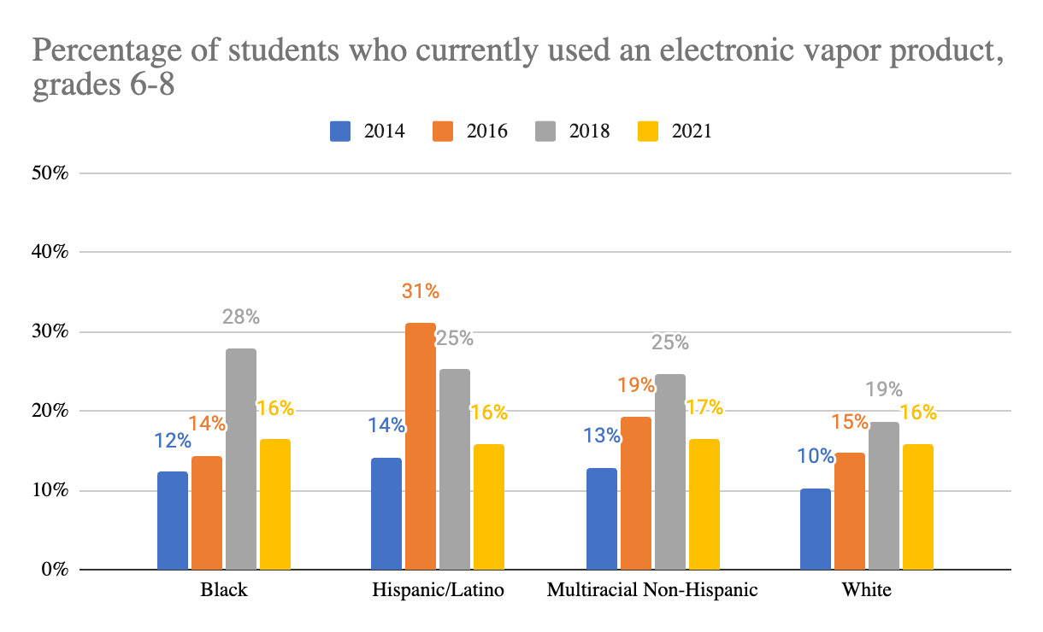
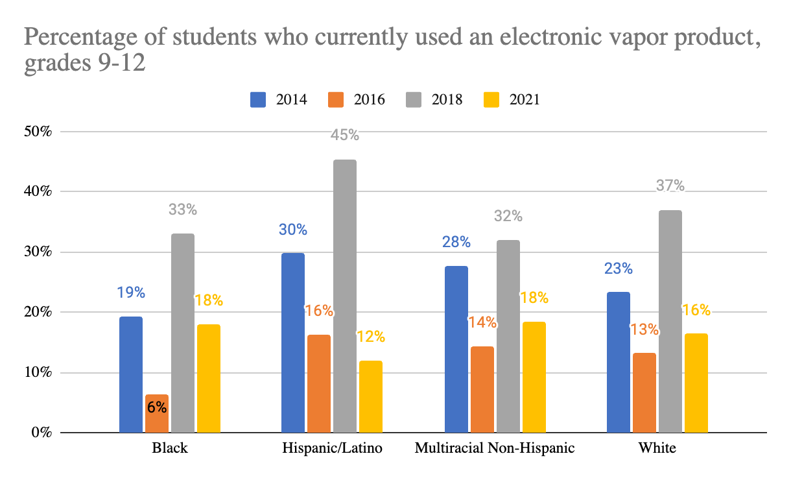
Child Health:
Electronic Vape Usage
Youth Risk Behavior Survey

Slide 50
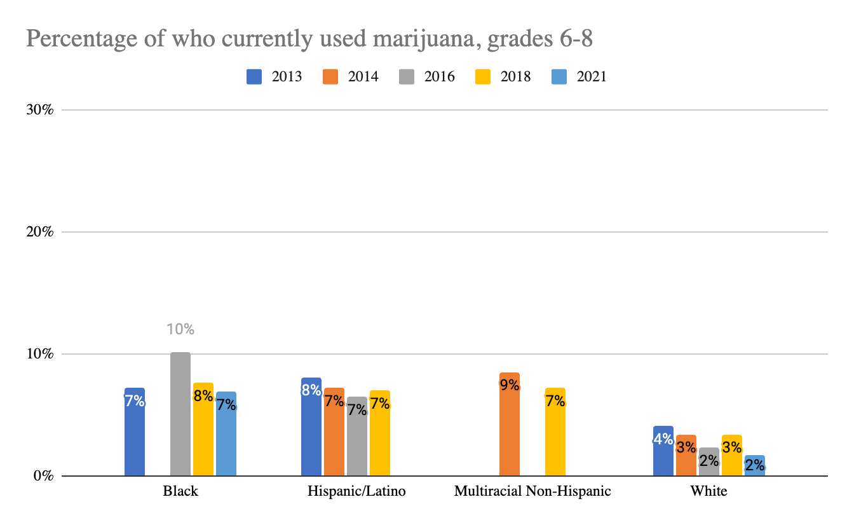
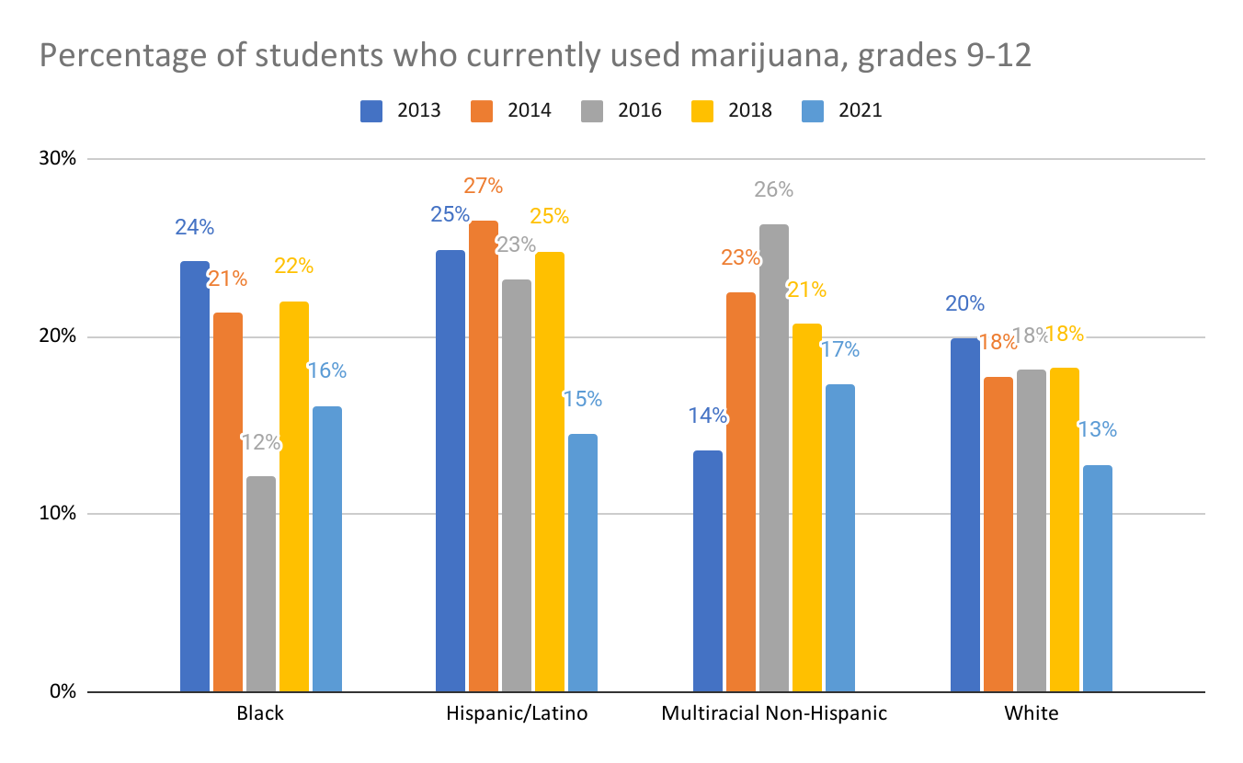
Child Health:
Marijuana Usage
*Data missing was not provided/suppressed in YRBS
Youth Risk Behavior Survey

Slide 51
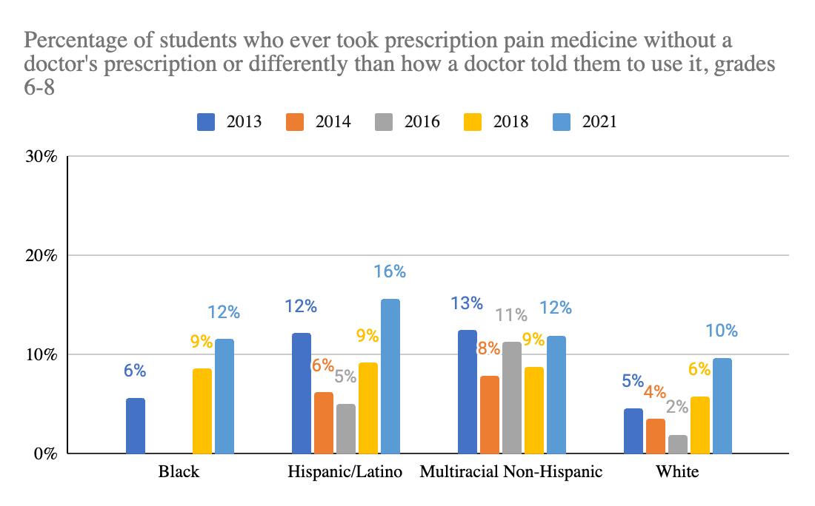
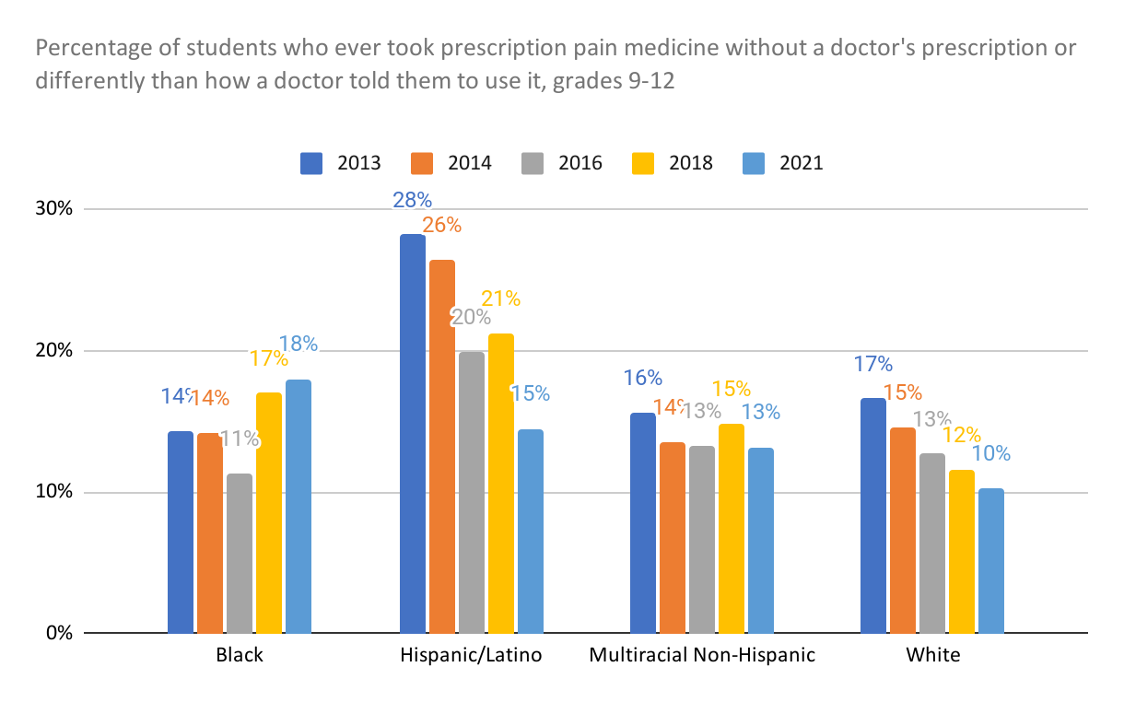
Child Health:
Prescription Drug Usage
*Data from 2013 on Black population of middle school students was not provided for 2014 and 2016
Youth Risk Behavior Survey

Slide 52
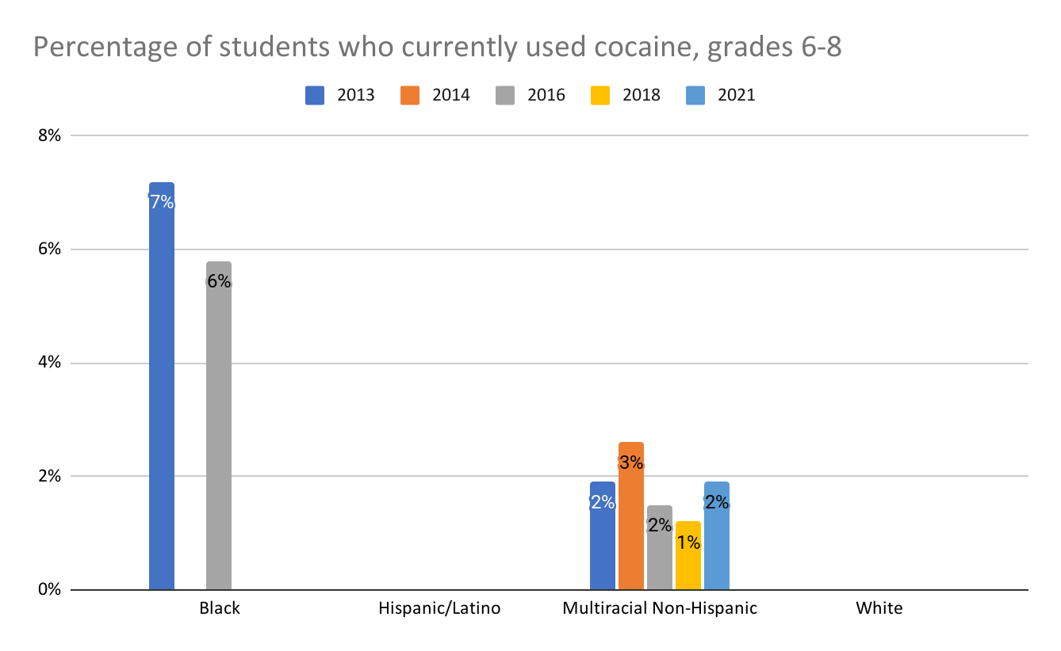
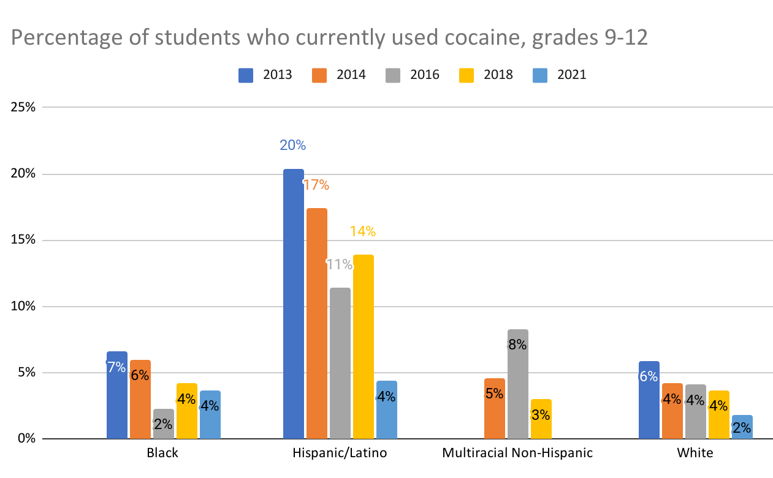
Child Health:
Cocaine Usage
Youth Risk Behavior Survey
*Data missing was not provided/suppressed in YRBS

Slide 53
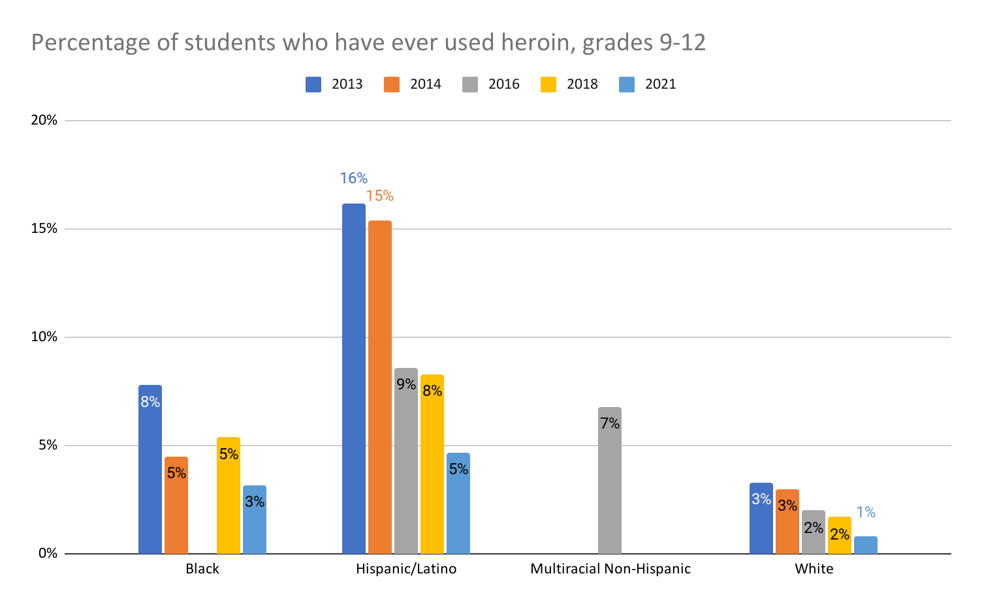
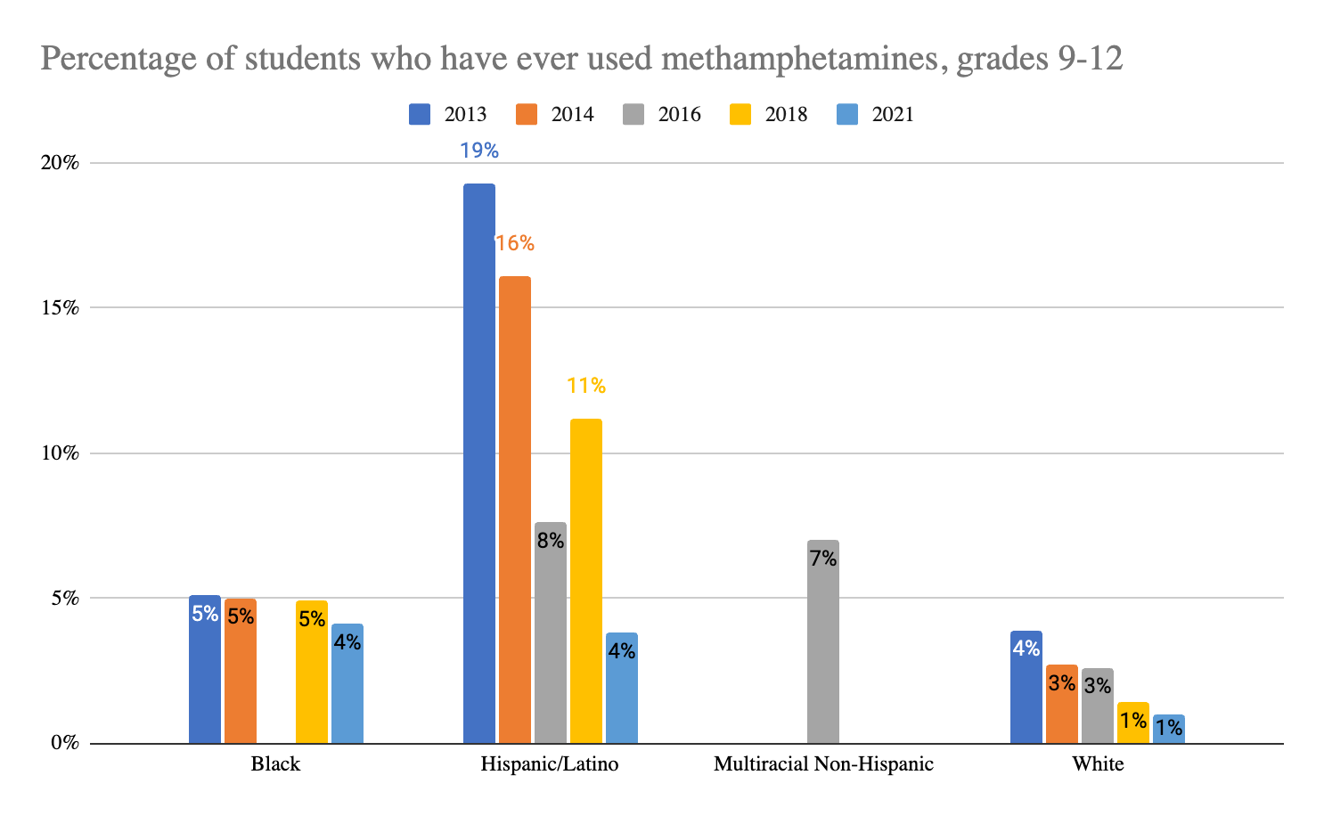
Child Health
Heroin Use
Methamphetamine Usage
Youth Risk Behavior Survey
*Data missing was not provided

Slide 54
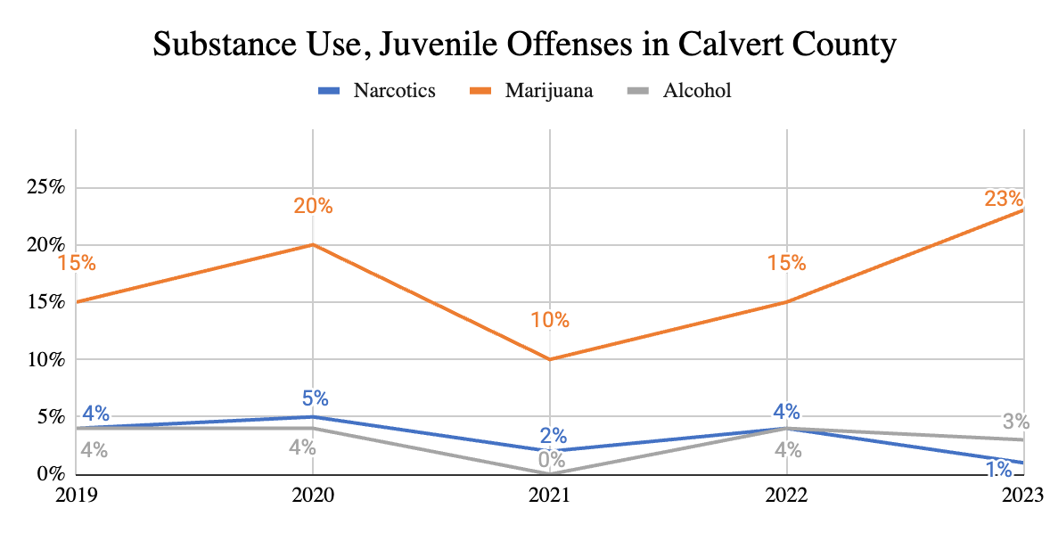
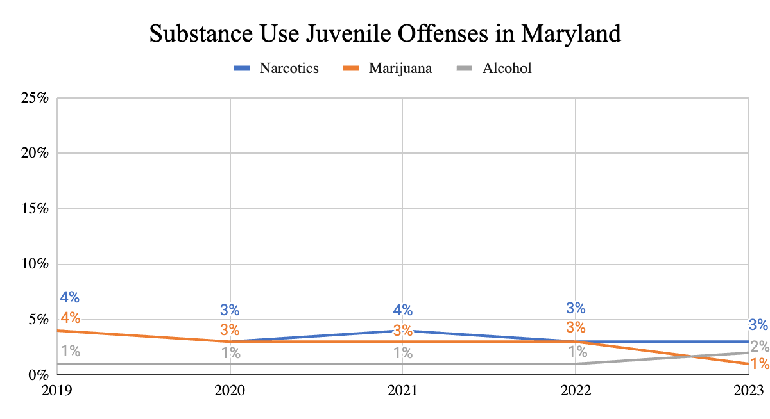
DJS Data Resource Guides
Child Health:
Substance Use: Juvenile Offenses

Slide 55

Children Enter School Ready to Learn

Slide 56
Why is this important?
Children Entering School Ready to Learn have a significant advantage in their educational journey. They are proficient in early learning fundamentals such as letters, shapes, colors and numbers, are better prepared to interact with teachers and peers and able to adapt to the school setting, which sets a strong foundation for future academic success. Being ready to learn also helps reduce achievement gaps that can arise early and persist throughout a child’s education. Additionally, children who start school prepared are more likely to develop positive attitudes toward education, fostering a lifelong love of learning.
The Kindergarten Readiness Assessment for Calvert County reveals disparities among our students entering Kindergarten:
The overall rate of Kindergarten readiness has remained steady; however, there are significant disparities between students with disabilities, English Language Learners and the Hispanic/Latino students
These persistent disparities in kindergarten readiness among students with disabilities, English Language Learners, and Hispanic/Latino students underscore a critical need for targeted interventions and systemic changes in early childhood education. These gaps can have long-lasting effects on academic achievement and future opportunities. Addressing these gaps requires a multi-faceted approach to ensure equitable access to high-quality early education programs, particularly in underserved communities. By focusing on these specific demographics and their unique needs, we can work towards closing the readiness gap and providing a more level playing field for all children as they begin their educational journey.
Together, we can work to ensure all children in Calvert County enter school ready to learn and embark on a solid path toward lifelong learning and discovering their full potential.

Slide 57
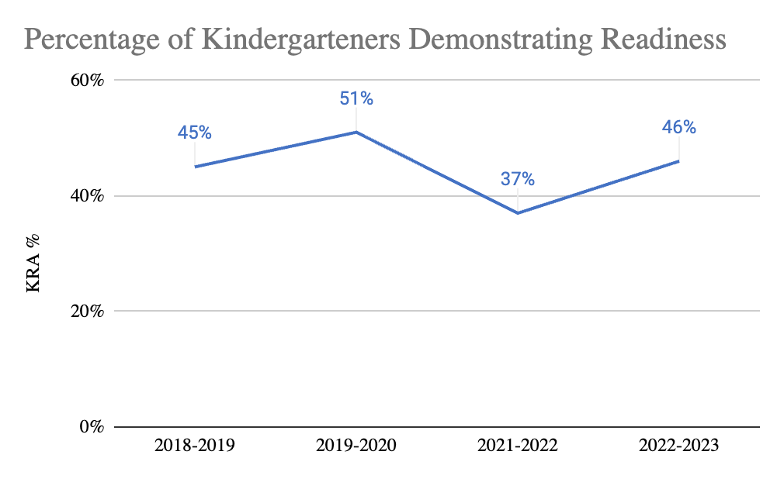
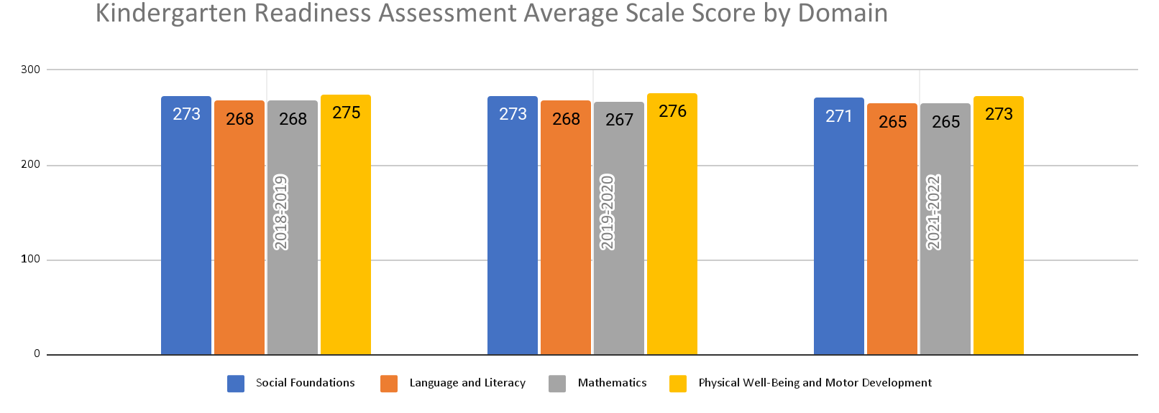
School Readiness:
Kindergarteners Demonstrating Readiness
Kindergarten Assessment: The percentage of composite scores for Maryland kindergarten students based on their readiness in the domains of the Maryland Kindergarten Assessment.
Kindergarten Readiness Assessment
*2020 – 2021 KRA Data unavailable due to COVID

Slide 58


School Readiness:
Kindergarteners Demonstrating Readiness by Subgroups
Kindergarten Readiness Assessment
*2020 – 2021 KRA Data unavailable due to COVID

Slide 59

School Readiness:
Kindergarteners Demonstrating Readiness by Subgroups
Kindergarten Readiness Assessment
*2020 – 2021 KRA Data unavailable due to COVID

Slide 60

Children are Successful in School

Slide 61
Why is this important?
When Children are Successful in School, it lays a crucial foundation for future opportunities and personal growth throughout their lifespan. It helps develop essential skills like critical thinking, self-confidence, time management, and motivation that encourages children to reach for higher goals and aspirations. A solid educational background opens doors to better education and career prospects, leading to improved financial stability and quality of life in adulthood.
Looking at school performance and school culture in Calvert County, the data shows:
MCAP ELA performance had remained relatively steady across grades 3 and 8 and MCAP Math performance for grade 3; overall performance for grade 8 MCAP math scores declined significantly from 2019-2022
Across both the ELA and Math MCAP test for grades 3 and 8, Black/African American students have the lowest rate of proficiency across all assessments
Bully and harassment rates were over 22x higher from 2020 (4) to 2022 (89), with females reporting the highest rates of bullying/harassment
While chronic absenteeism declined between 2022-2023, it is still 2x’s higher than it was in 2021 with homeless students, FARMS eligible students, and students with disabilities having the lowest rates of attendance
The achievement gap for Black/African American students across all MCAP assessments, significant increase in reported bullying and harassment disproportionately affecting female students and chronic absenteeism mostly affecting students with disabilities, students from low-income families or those experiencing homelessness, illustrate specific challenges affecting children’s experience and success in school.
Collectively, these findings highlight the urgent need for targeted academic interventions, enhanced school safety measures, and focused strategies to boost attendance and engagement, particularly for the most at-risk student groups. Beyond the school walls, the data illustrates the need for comprehensive, community-wide solutions to address root causes (poverty, racism, gender bias) and create a more equitable, safe, and effective learning environment for all students.

Slide 62


MSDE Report Card
School Success:
Grade 3 MCAP Performance at Proficient or Above in English Language Arts
Academic Performance: The average percent of public school students in third grade through eighth performing at or above performance level 4 on the Partnership for Assessment of Readiness for College and Career (PARCC) in English language arts and mathematics.
Notes:
The percentage for the Native American/Alaskan Native is ≤5 and the data was suppressed
2020-2021 School Year is excluded due to COVID

Slide 63


MSDE Report Card
School Success:
Grade 3 MCAP Performance at Proficient or Above in Math
Notes:
The percentage for the Native American/Alaskan Native is ≤5 and the data was suppressed
2020-2021 School Year is excluded due to COVID

Slide 64


MSDE Report Card
School Success:
Grade 8 MCAP Performance at Proficient or Above in English Language Arts
Notes:
The percentage for the Native American/Alaskan Native is ≤5 and the data was suppressed
2020-2021 School Year is excluded due to COVID

Slide 65


MSDE Report Card
School Success:
Grade 8 MCAP Performance at Proficient or Above in Math
Notes:
The percentage for the Native American/Alaskan Native and Asian populations are ≤5 and the data was suppressed
2020-2021 School Year is excluded due to COVID

Slide 66

2021-2022 Bullying, Harassment, or Intimidation in Maryland Public Schools Report
School Success:
Bullying and Harassment
Bullying and Harassment: Bullying is a form of aggression between a more powerful antagonist and his/her/their victim. Bullying can be physical, verbal and/or psychological and can be direct or indirect. Bullying occurs across all age groups and includes sexual harassment, dating violence, gang attacks, domestic abuse, child abuse and elder abuse. For this indicator, the office tracks “Total Number of Bullying or Harassment Incidents Reported, by Academic Year.”
*Number of students who reported bullying in 2020-2021 is lower than other years due to all students attending school at home

Slide 67


2021-2022 YRBS
School Success:
High School Students Bullied on School Property
Notes:
The data for Asian Males and Females and all Native American population subgroups was suppressed due to >30 students in the subgroup

Slide 68


2021-2022 YRBS
School Success:
High School Students Bullied Electronically
Notes:
The data for Asian Males and Females and all Native American population subgroups was suppressed due to >30 students in the subgroup

Slide 69


School Success:
Chronic Absenteeism
Truancy/Absenteeism: Percentage of students in all grades (public schools) absent more than 20 days of the school year (excluding summer school).
MSDE Report Card

Slide 70

MSDE Report Card
School Success
Notes:
Below is a list of data that was suppressed due to too low or too high of a percentage by subgroup:
  2019-2023 Asian population
  2019 and 2021 American Indian/Alaskan Native populations
  2021 Hispanic population
  2021 2+ races
  2021 Overall

Slide 71

School Success
School Quality and Student Success by School Type
*2020 – 2021 MSDE Data unavailable due to COVID
**This indicator describes a number of aspects of school performance that are not measured by standardized tests. It
combines measures of chronic absenteeism, the percent of students with access to a well-rounded curriculum,
and the Maryland School Survey.
MSDE Report Card

Slide 72
- % of students who report feeling safe at school
- % of students reporting at least 1 adult in their school cares about them
Current Needs Assessment source: Calvert County Board of Education Strategic Plan Update, July 2019, Climate & Culture. Provided by Student Services.
School Success

Slide 73

Youth Will Complete School

Slide 74
Why is this important?
When Youth Complete School, they gain essential knowledge and skills that help form the foundation for future success. Education is the doorway to diverse career opportunities and increased earning potential, as most jobs require a minimum of a high school diploma and many require a college degree or career certification. Education also enhances critical thinking, problem-solving abilities, and social skills, which are valuable in all aspects of life.
Similar to earlier indicators of child well-being, most students in Calvert County graduate high school on time. While graduation rates have remained relatively stable above 94% since 2018-2019 and fewer than 4% of students drop out prior to graduating, the data shows significant disparities among student subgroups:
Students from low-income families (eligible for Free And Reduced Meals or FARMS), those with disabilities and multi-language learners have a significantly lower graduation rate compared to all other subgroups
Homeless students are approximately 5 times more likely to drop out than their housed peers
This “opportunity gap” underscores the need for a comprehensive support system and targeted interventions to address gaps and achieve greater equity in education. Together, we need to work to ensure that all students, regardless of their background or circumstances, have the opportunity to successfully complete school.

Slide 75


Youth Will Complete School:
High School Diploma or Equivalent
Educational Attainment: The percent of young adults ages 18 through 24 who have not completed high school, completed high school, completed some college or an associate’s degree, or attained a bachelor’s degree or higher
2019-2022 US Census ACS - 1 Year Estimates

Slide 76


Youth Will Complete School:
Some College and Higher
2019-2022 US Census ACS - 1 Year Estimates

Slide 77

Youth Will Complete School:
CTE Programs

Slide 78

Youth Will Complete School:
Graduation Rate
Notes:
The data was suppressed for the following sub groups due to too few students or too high of a percentage:
  Native American/Alaskan Native population
  Asian population
  2019-2023 SY Data for White population
  2019-2020 2+ race population
  2019-2022 Multilingual learners
  2019-2020 and 2021-2020 Overall
High School Program Completion: The percentage of high school graduates who successfully completed the minimum course requirements needed to enter the University System of Maryland, complete an approved Career and Technology education program, or who completed requirements for both, by Academic Year
MSDE Report Card

Slide 79

Youth Will Complete School:
Dropout Rate
Notes:
The data was suppressed for the following sub groups due to too few students or too low of a percentage:
  Native American/Alaskan Native population
  2019, 2021, and 2023 Asian population
  2022 Hispanic population
  2019-2023 SY Data for White population
  2020 2+ race population
  2022 Overall
High School Dropout: The number of students who leave school, for any reason other than death, within the four year period divided by the number of students who form the adjusted cohort. The cohort dropout rate is adjusted to show rate of individuals.
MSDE Report Card
Notes:
Less than 4% of overall students drop out prior to graduating; however, the homeless student drop out rate has been about 5x’s higher than the overall dropout since 2019

Slide 80

Youth Will Complete School
MSDE Report Card
Notes:
The 2021 Homeless Student data was suppressed due too low of a percentage

Slide 81


Youth Will Complete School
Program Completion of Students with Disabilities: The percentage of students with disabilities ages 14 through 21, who graduate or complete school. High school program completion reflects the percentage of students obtaining diplomas and certificates. This data looks at the percentage of special education program participants and students with current Individualized Education Plans (IEPs) who complete a high school certification or receive a diploma.
MSDE Report Card

Slide 82

Youth Have Opportunities for Employment or Career Readiness

Slide 83
Why is this important?
There are many pathways to financial stability and professional achievement including college and career. Ensuring Youth Have Opportunities for Employment or Career Readiness provides them with opportunities crucial for their personal and professional development. These experiences allow young people to pursue their interests in real-world settings, develop essential workplace skills, and gain valuable insights into potential career paths. Early work experiences can also boost confidence, foster financial independence, and help youth build professional networks that may benefit them throughout their careers. Providing youth with vital job opportunities reduces youth unemployment and contributes to the overall economic growth in our communities.
The employment picture for youth in Calvert County has been improving steadily over the last 5 years:
The number of disconnected youth (not in school or working) has been slowly decreasing since 2018 (855 in 2018 to 800 in 2021)
While teens (16-19-years-old) are more likely to be unemployed compared to their older peers (20-24 years old), overall unemployment for youth age 16-19 dropped 10% from 2019 to 2022 and dropped 8% for 20-24-year-olds from 2021 to 2022
These trends suggest a growing recognition of the importance of youth in the workforce and effectiveness of initiatives aimed at supporting them to find pathways to education or employment.

Slide 84

Youth Opportunities:
Not Working and Not in School
Youth Employment: The percentage of young adults ages 16 through 24 who are in the labor force
Opportunity Index & Measure of America
*2020 data excluded due to COVID

Slide 85


Youth Opportunities:
Employment
*No data from 2020 due to lack of reporting during COVID Pandemic
The United States Census - American Community Survey

Slide 86

Communities are Safe for Children, Youth and Families

Slide 87
Why is this important?
Communities that are Safe for Children, Youth, and Families create an environment where everyone can thrive. When children and youth feel secure, they're more likely to explore, learn, and demonstrate hope for their future.. Safe communities foster social connections, allowing families to build supportive networks and engage more fully in community life. Communities where children, youth and families feel safe have lower crime rates, better public health outcomes, and increased property values, benefiting the entire community. Ultimately, investing in community safety enhances the overall quality of life for all residents.
In Calvert County, crime-related data revealed:
Juvenile offenders are most likely to be white males between the ages of 15 - 17
More than half of juvenile offenses stem from possession of marijuana and misdemeanor assault
With a the exception of a small decline in 2021, Calvert County has seen an increase violent crimes year over year since 2018
Youth engaged with the criminal justice system or using substances before adulthood can negatively affect their future, often leading to more serious offenses and harsher consequences. The impact on families, schools, and the broader community is equally significant, straining relationships and resources and eroding community safety.
The data raises some critical questions about existing underlying social and economic factors that may be contributing to these trends and the effectiveness of current support systems for youth and the broader community. Addressing these challenges will require a coordinated effort from everyone in our community, focusing on prevention, early intervention, and comprehensive support for at-risk youth. By closing the gap and providing more support to our young people, Calvert County has the opportunity to create a safer, more promising future for all residents.

Slide 88

Safe Communities:
Child Maltreatment
Child Maltreatment: Child Protective Services (CPS) investigations are ruled “indicated” where credible evidence is not satisfactorily refuted, or “unsubstantiated” where insufficient evidence is found to support a finding as either indicated or ruled out.
MD Department of Human Services

Slide 89


Safe Communities:
Children in Care of the Department of Social Services
MD Department of Human Services

Slide 90

Safe Communities:
Out of Home Placements
Out of Home Placements (OOH): The number of out-of-home placements that occur per 1,000 children in the population.
Governor’s Office of Crime Prevention and Policy

Slide 91

Safe Communities:
Child Maltreatment
2021-2022 YRBS Report

Slide 92


2021-2022 YRBS Report
Safe Communities:
Child Maltreatment, con’t.
Notes:
Overall, Calvart County has a lower percentage of high school students who report someone in their household going to jail/prison; however, it disproportionately affects Black and Multi-racial students
Multi-racial high school students report living with someone who has a substance use problem as well as someone with mental health challenges at a significantly higher rate than any other racial subgroup in Calvert County

Slide 93

Safe Communities:
Child Maltreatment
2021-2022 YRBS Report

Slide 94

Safe Communities:
Violent Crime
Violent Crime: The rate of violent crimes (murder, rape, robbery, and aggravated assault) that are committed per 1,000 persons.
Maryland County Crime Dashboard, 202 Uniform Crime Report 2, 2023 GOCCP Annual Report

Slide 95


Safe Communities:
Juvenile Recidivism
Juvenile Recidivism: Juvenile and adult re-adjudicated/convicted recidivism rates for youth released from Department of Juvenile Service (DJS) committed programs after 12, 24 and 36 months.
DJS Recidivism Rates and Outcome Measures

Slide 96


Department of Juvenile Services Data Resource Guide 2023
Safe Communities:
Juvenile Complaints

Slide 97

Safe Communities:
Juvenile Offenses
Definition: The rate of referrals to the Department of Juvenile Services (DJS), per 100,000 youth ages 10-17, for felony offenses, including both violent and non-violent charges—based on the Maryland Sentencing Commission which utilizes the definition of ”crime of violence” found in the Maryland Code, Correctional Services Article, § 7-101(m) which defines violent crime as a crime of violence as defined in §14-101 of the Criminal Law Article, or burglary in the 1st, 2nd, or 3rd degree. Maryland Code, Criminal Law Art., §14-401 lists violent offenses as: murder; manslaughter, except involuntary manslaughter; forcible rape; first degree sex offense; second degree sex offense with force or threat; robbery; use of a hand gun in the commission of a felony or other crime of violence; child abuse; carjacking; aggravated assault; and arson – first degree. Non-violent felony offenses include breaking and entering, theft, motor vehicle theft, controlled dangerous substance (CDS) distribution and manufacturing, assault on police officer, third degree sex offense with or without force, arson–second degree, destructive devices and conspiracy to commit any felony offense.
Department of Juvenile Services Data Resource Guide 2023

Slide 98

Safe Communities: Juvenile Offenses in Calvert County
Department of Juvenile Services Data Resource Guide 2023

Slide 99

Families are Economically Stable

Slide 100
Why is this important?
When Families are Economically Stable, it provides a foundation for overall well-being and future success for the entire family. It allows parents to meet their children's basic needs, including nutritious food, safe housing, healthcare, etc. While no guarantee of family stability, economically stable families tend to experience less stress and anxiety within the household triggered by financial insecurity. Without the constant worry of not having enough money to pay bills or meet vital expenses, these families have more freedom and resources to invest in their children’s recreational and educational opportunities and pursue their own life goals.
Recent data from Calvert County provides crucial insights into the economic stability of our families:
Child food insecurity has a disproportionate impact on low-income families and families of color even as rates have decreased significantly overall from 12.6% in 2018 to 4% in 2022
Across all grade levels, there has been an increase year over year in economically disadvantaged children and children participating in FARMS since 2019
From 2021 to 2022, there was a 29% increase in the number of food insecure children who did not quality for FARMS assistance
White households have the highest proportion above the ALICE (Asset Limited, Income Constrained, Employed) threshold, while Black and Hispanic households have higher proportions below the ALICE threshold
The cost of child care (family and center-based) increased year over year for almost every age group since 2020
Despite the overall reduction in childhood hunger in our County, the rising cost of food and child care adds financial strain to already struggling households, especially families who earn too much money to qualify for government benefits but not enough to afford healthy food or high-quality child care.
When children are hungry they struggle to learn. And when they do not receive quality early education, they start kindergarten already behind their peers. Investments in targeted family support and resources help more households achieve economic stability and ensures all of our children and families have the opportunity to thrive.

Slide 101

Economic Stability:
Food Security Index
Calvert Health Needs Assessment

Slide 102


MD Report Card
Economic Stability:
Financial Hardship

Slide 103



Economic Stability:
Survey of Services to Homeless Persons
Homelessness: The percentage of children enrolled in the public school system who lack a fixed, regular, and adequate nighttime residence or who are awaiting foster-care placement
Survey of Services Reports 2019-2021

Slide 104


Economic Stability:
Survey of Services to Homeless Persons by Gender and Race
Survey of Services Report 2020-2021

Slide 105

Economic Stability:
Financial Hardship Year over Year (YOY)
ALICE Data 2022

Slide 106

Economic Stability:
Financial Hardship
ALICE Data 2022

Slide 107


Economic Stability
Cost of Family Child Care Programs
Cost of Child Care Centers
1 Average cost of full time care for a 5 year old. Defined as child being in full time child care or being in kindergarten and out-of-school child care, i.e., holidays, school closures and summers. 2 Average cost of full time care for a 6+ school age child (out-of-school child care, i.e., holidays, school closures and summers). 3 Average cost of before and after school child care.
MD Family Network
Notes:
YOY, the cost of child care programs (family and center-based) increased for almost every age group since 2020

Slide 108


Economic Stability:
Childhood Poverty
Annie E. Casey, Data Center
Census Bureau, American Community Survey
Child Poverty: The number of out-of-home placements that occur per 1,000 children in the population.
Notes:
Child Poverty - https://data.census.gov/cedsci/table?q=%20Poverty,%20Under%2018%20years%20old%20in%20Charles%20County,%20Maryland

Slide 109


Feeding America
Economic Stability:
Hunger
Hunger: The percentage of families who are food insecure. The U.S. Department of Agriculture (USDA) defines food insecurity as a measure of the lack of access, at times, to enough food for an active, healthy life for all household members; limited or uncertain availability of nutritionally adequate foods.

Slide 110

Economic Stability:
Housing Vacancies
Annie E. Casey, Data Center
Notes:
Affordable housing - https://reports.nlihc.org/oor/maryland

Slide 111


Economic Stability:
Rental Housing Burden
National Low Income Housing Coalition
Notes:
Affordable housing - https://reports.nlihc.org/oor/maryland

Slide 112

Economic Stability:
Housing
2023 Housing Units: 36,309
Median value of owner-occupied housing units, 2018-2022: $418,900
  Compared to United States: $281,900
Median selected monthly owner costs -with a mortgage, 2018-2022: $2,296
  Compared to United States: $1,828
U.S. Census Bureau
Notes:
Affordable housing - https://reports.nlihc.org/oor/maryland

Slide 113
Addendum

Slide 114
Internal and External Survey Response Demographics

Slide 115
Who We Heard From - 149 Total
Community Survey (102 Respondents - respondents were able to select all that applied)
Parent or Caregiver (25%) | 40
Community Partner (16%) | 26
Community Member (14%) | 23
Government Agency Partner (11%) | 18
Nonprofit (9%) | 15
Child Care Provider (8%) | 13
Teacher/School Administrator (8%) | 12
Community Advocate (4%) | 6
Other (Library, Board Member, Healthcare Provider/Physician, Social Worker) (4%) | 6
Key Informants (9 Interviewees)
Sheriff’s Office | 2
Youth Centers | 2
Public Schools (DSS) | 1
DJS | 1
LBHA | 1
CCFN - Open Table | 1
Community Activist | 1
Focus Groups (2 Groups - 38 people)
IAC | 26
Youth | 12

Slide 116


What is Your…
Age?
(98 Responses)
Community Survey
Zip Code?
(102 Responses)
Notes:
Include in board slides

Slide 117


What is Your…
Race/Ethnicity?
(89 Responses)
Community Survey
Gender?
(94 Responses)
Notes:
Include in board slides

Slide 118
Community Health Needs Assessment (CHNA); https://www.calverthealthmedicine.org/Uploads/Public/Documents/CommunityResources/CalvertHealth%20FY%202023-2025%20CHNA%20Report%20Final.pdf
Maryland State Department of Education; https://reportcard.msde.maryland.gov/Graphs/#/AtaGlance/Index/3/17/6/04/XXXX/2023
Calvert County Public School District; https://www.calvertnet.k12.md.us/district-information
Youth Risk Behavior Survey; https://health.maryland.gov/phpa/ccdpc/Reports/Pages/State-Level-Data,-2021-2022.aspx
The United States Census; https://data.census.gov/profile/Calvert_County,_Maryland?g=050XX00US24009
Maryland Family Network Child care Demographic Survey; https://www.marylandfamilynetwork.org/sites/default/files/2024-01/Calvert.pdf
Kindergarten Readiness Assessment; https://earlychildhood.marylandpublicschools.org/kindergarten-readiness-report
Maryland Department of Health; https://health.maryland.gov/vsa/Pages/reports.aspx
Maryland Department of Human Services; https://dhs.maryland.gov/business-center/documents/data-and-reports/
Calvert County Department of Health; https://www.calverthealth.org/
Annie E. Casey, Data Center; https://datacenter.aecf.org/data?location=MD#MD/5/0/char/0
Feeding America; https://map.feedingamerica.org/county/2018/child/maryland/county/calvert
Healthy Calvert; https://www.healthycalvert.org/
Bullying, Harassment, or Intimidation in Maryland Public Schools SY 2021-2022: https://marylandpublicschools.org/about/Documents/DSFSS/SSSP/Bullying/Bullying-Legislative-Report-2021-22.pdf
National Low Income Housing Coalition; https://nlihc.org/oor/state/md
ALICE Data 2022; https://www.unitedforalice.org/maryland
Survey of Services Annual Reports
Maryland County Crime Dashboard, 202 Uniform Crime Report 2, 2023 GOCCP Annual Report; https://app.powerbigov.us/view?r=eyJrIjoiMDMxZjkzNDUtZTEyZi00MGNmLTkwMTUtMWEwNGVmZTdlMWZkIiwidCI6IjYwYWZlOWUyLTQ5Y2QtNDliMS04ODUxLTY0ZGYwMjc2YTJlOCJ9&pageName=ReportSection4
Department of Juvenile Services Data Resource Guide 2023; https://djs.maryland.gov/Documents/DRG/Data_Resource_Guide_FY2023.pdf
DJS Recidivism Rates and Outcome Measures; https://djs.maryland.gov/Documents/DRG/Recidivism.pdf
Governor’s Office of Crime Prevention and Policy; https://gocpp.maryland.gov/
MARF Data Report
Annual Report on Behavioral Health Services for Children
Maryland Vital Statistics Reports 2018; https://health.maryland.gov/vsa/Documents/Reports%20and%20Data/Annual%20Reports/2018annual_rev3.pdf
Maryland Vital Statistics Reports 2019; https://health.maryland.gov/vsa/Documents/Reports%20and%20Data/Annual%20Reports/2019Annual.pdf
Maryland Vital Statistics Reports 2020; https://health.maryland.gov/vsa/Documents/Reports%20and%20Data/Annual%20Reports/2020Annual.pdf
Maryland Vital Statistics Reports 2021; https://health.maryland.gov/vsa/Documents/Reports%20and%20Data/Annual%20Reports/2021AnnualReport_Final_v1023.pdf
Quantitative Data Sources

